Slide 1
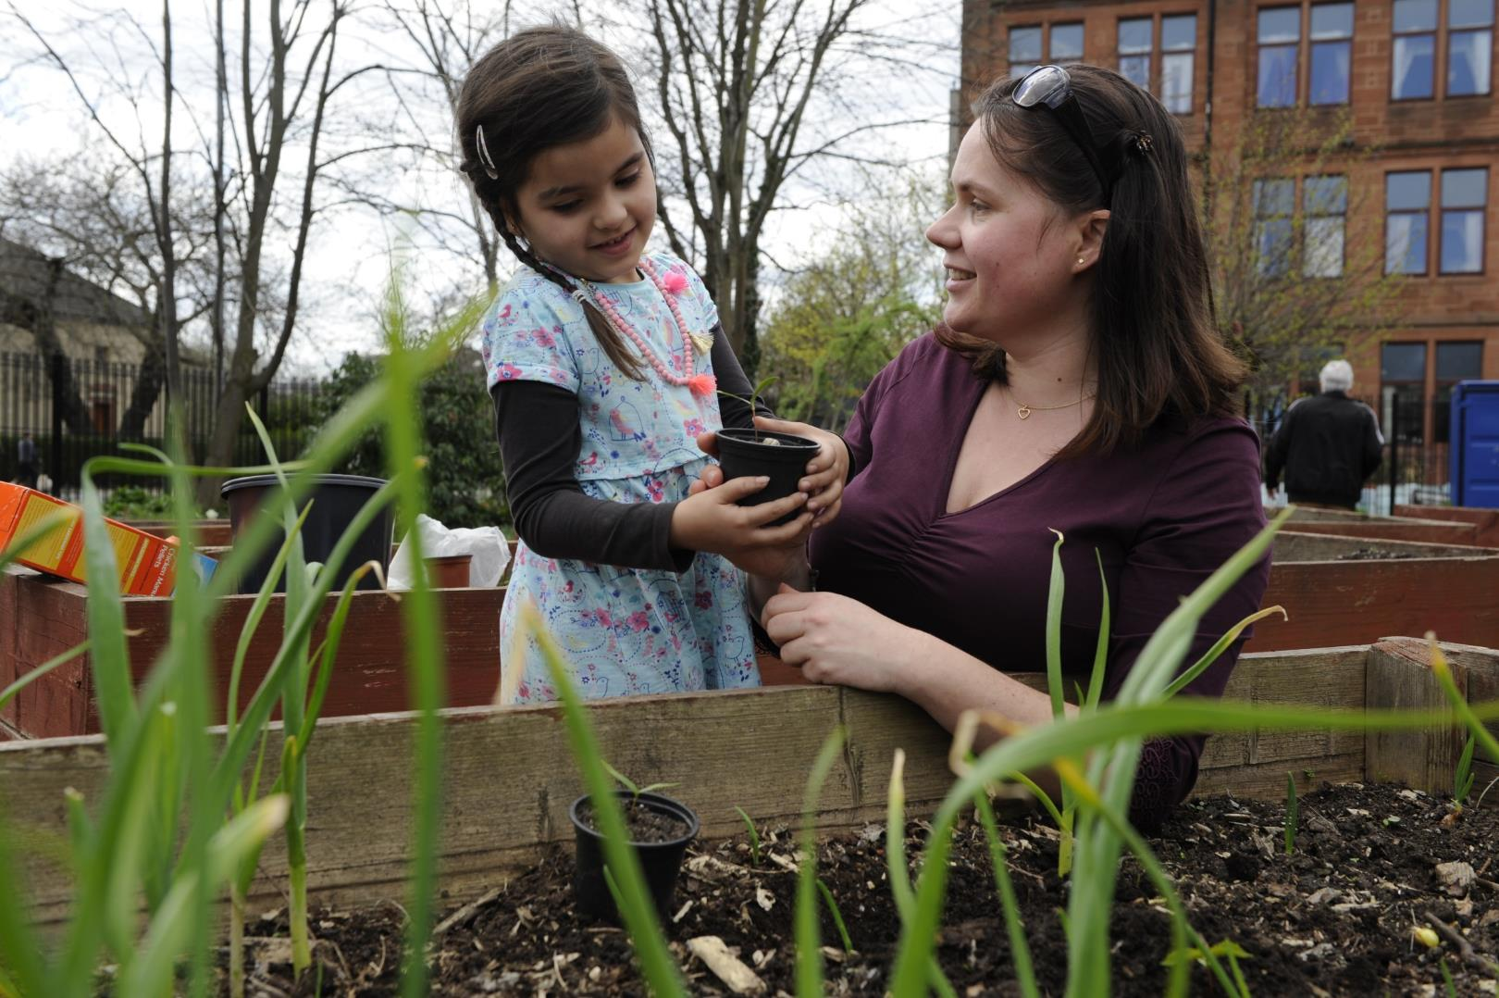

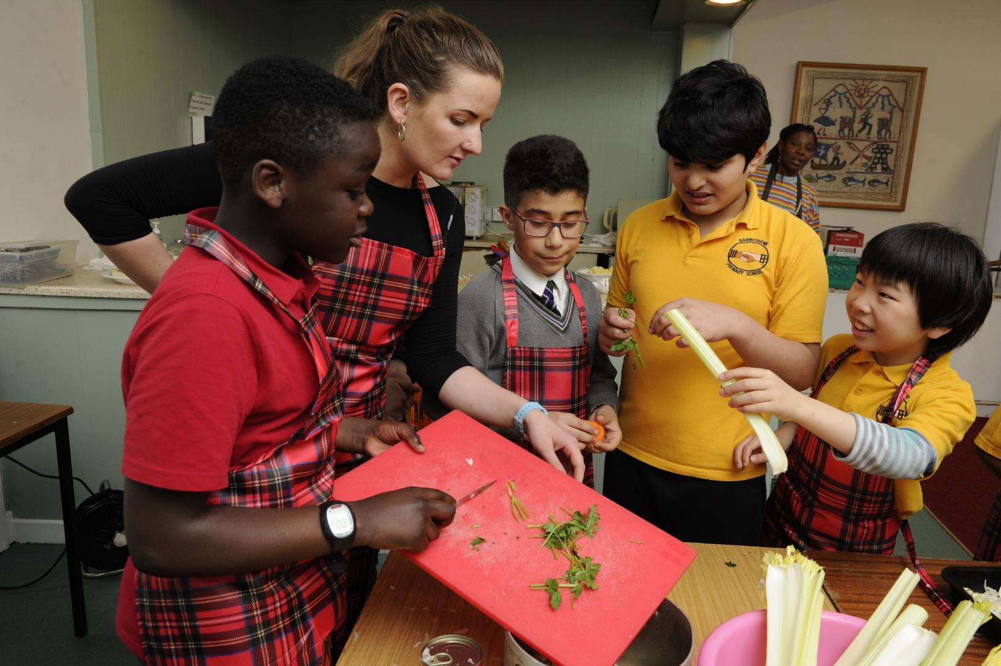
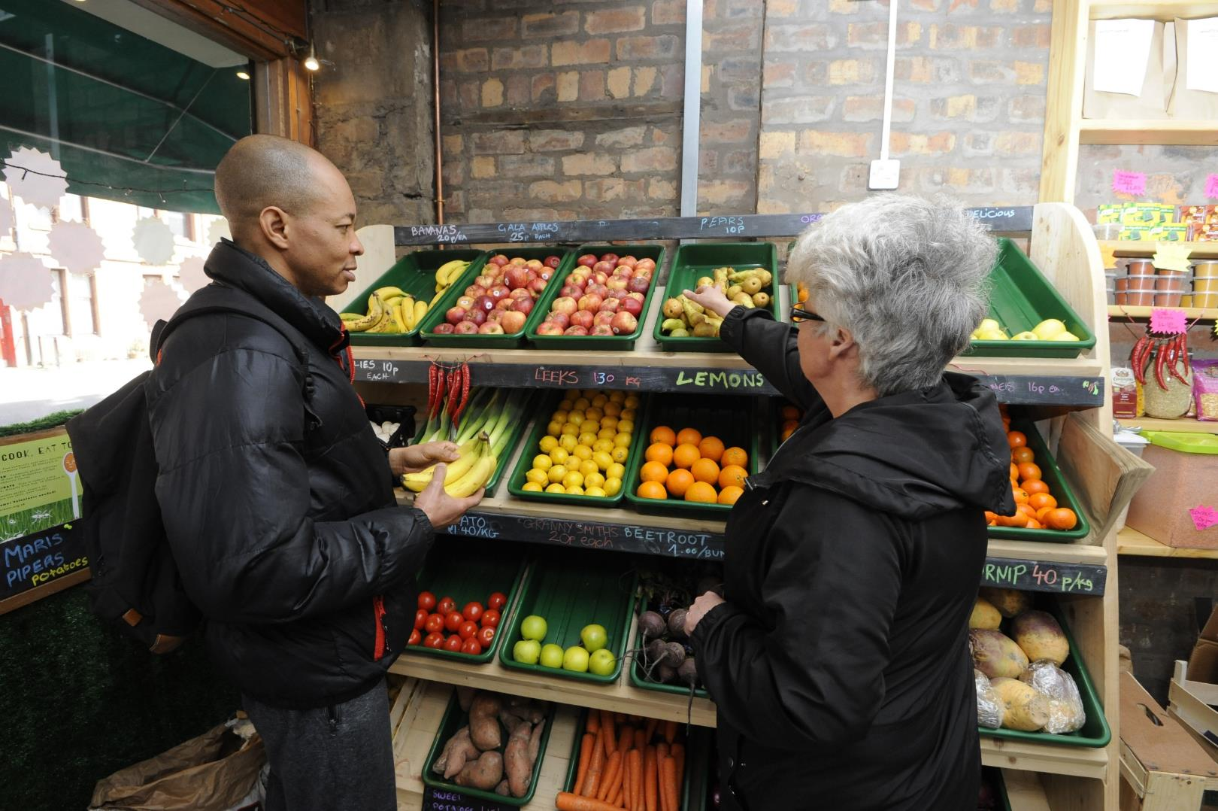
Prof Wendy Wills
Professor of Food and Public Health
and Director of the Centre for Research
in Public Health and Community Care
at the University of Hertfordshire

Slide 2

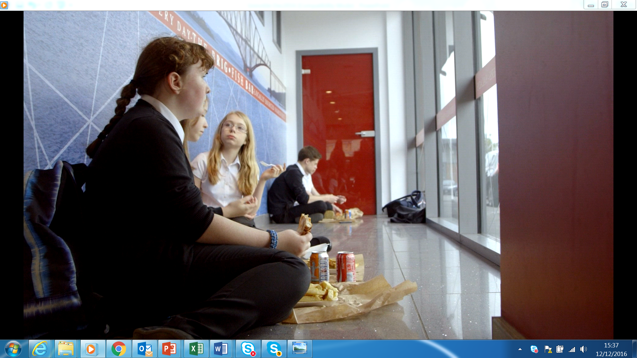
The priceless role of lived experience in research on food and eating
Wendy wills, professor of food and public health, university of hertfordshire
Email: w.j.wills@Herts.ac.uk

Slide 3
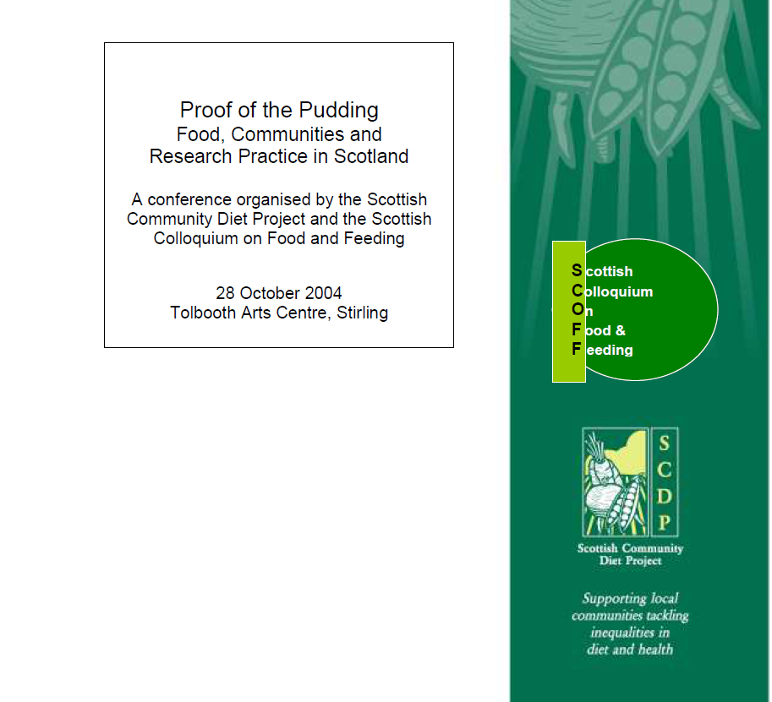
Notes:
Fare Choice – SCOFF articles from issue 18-34 (2002-2005) – 17 articles

Slide 4
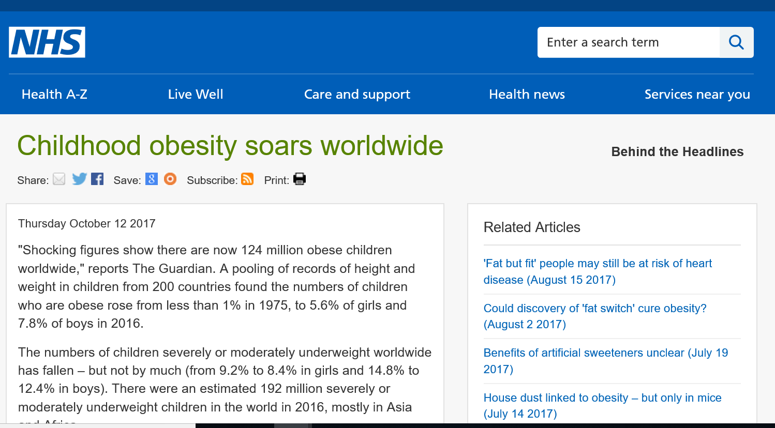
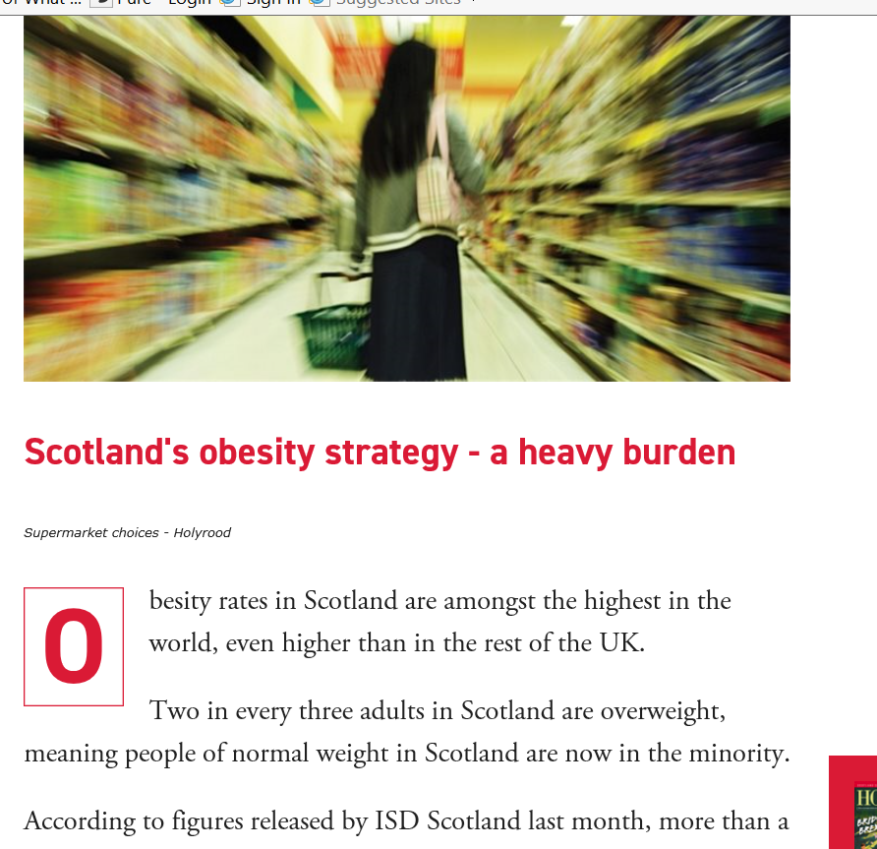
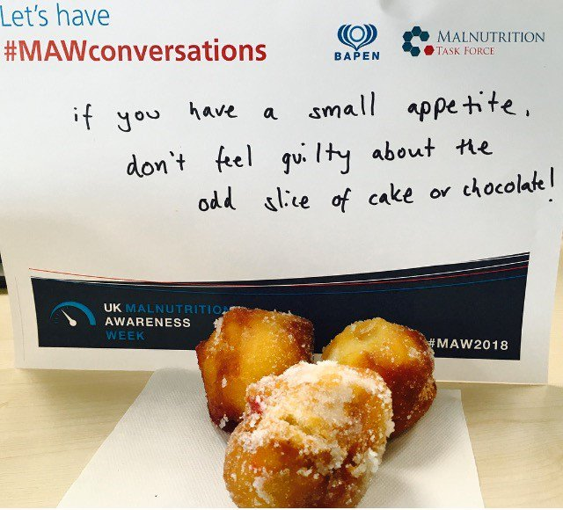
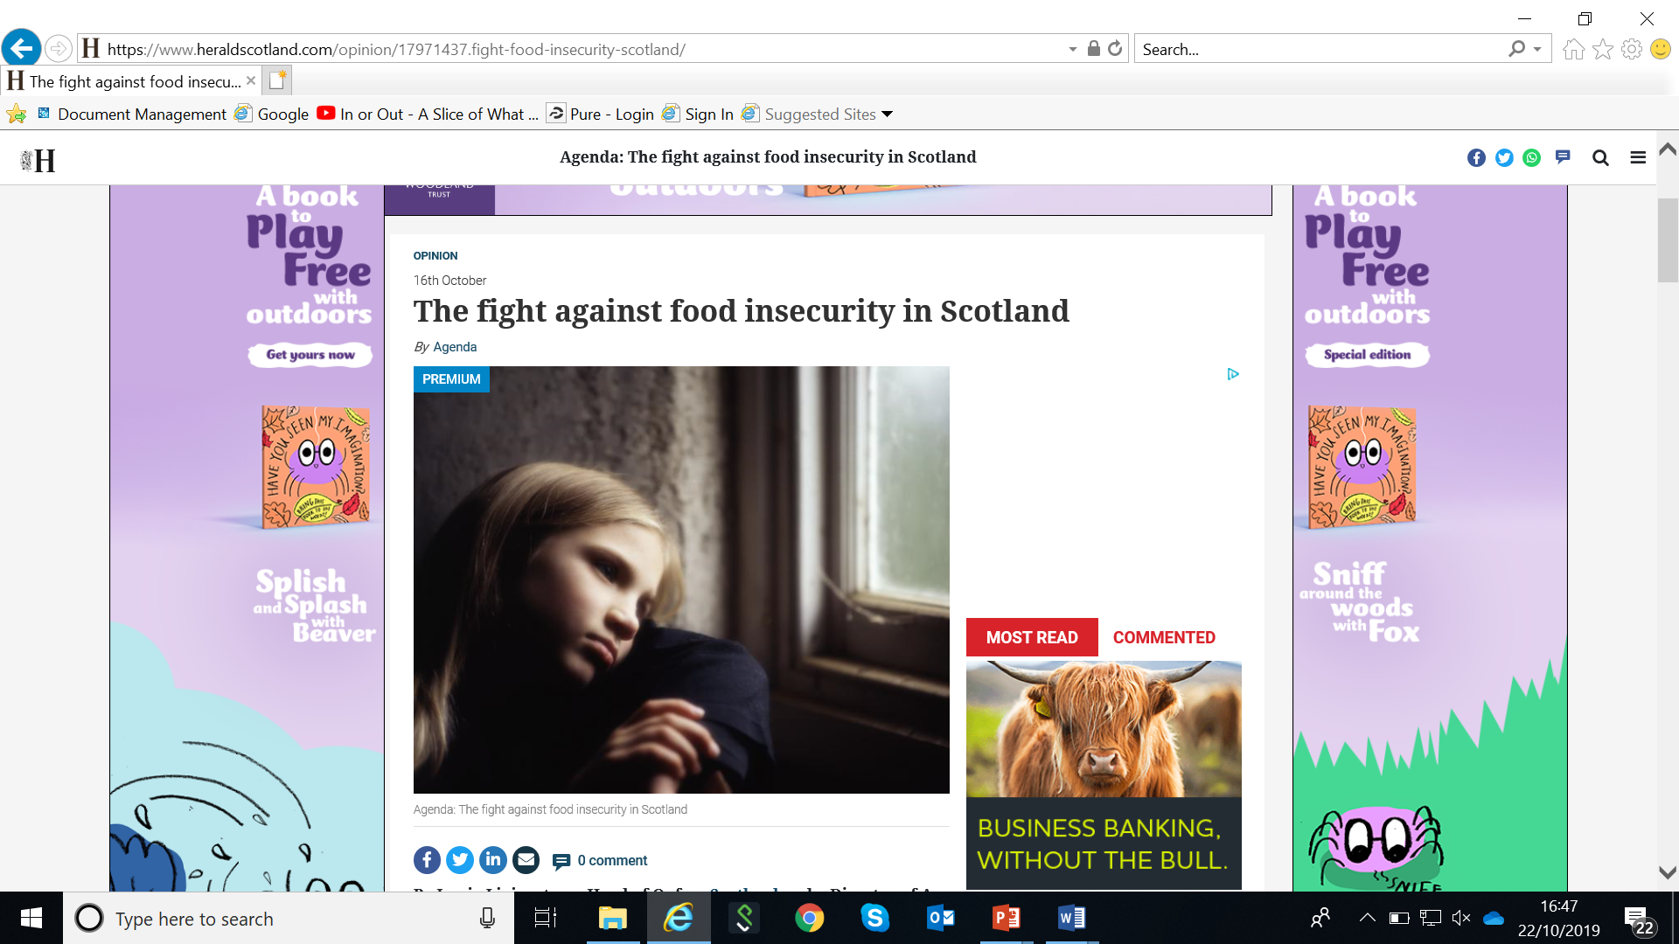
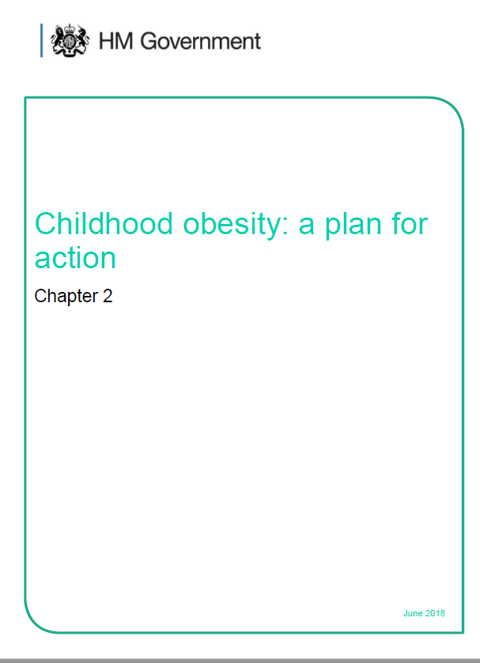
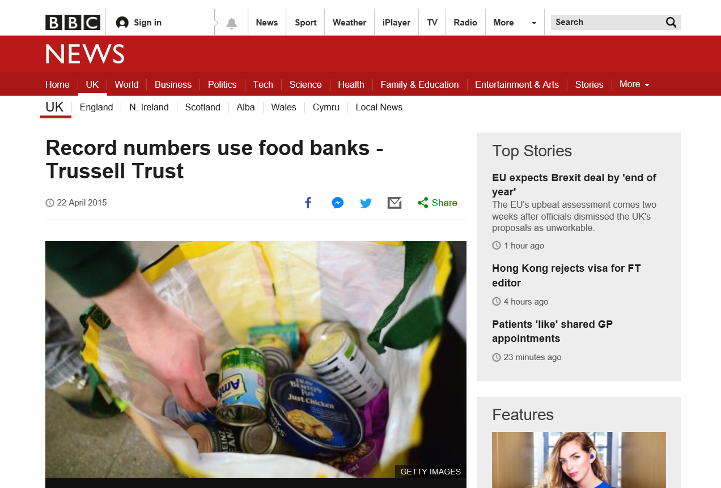
The priceless role of lived experience in research on food and eating
Wendy wills, professor of food and public health, university of hertfordshire
Notes:
What is the lived experience of a food system or context that on one hand shows we have a problem with childhood obesity and steps need to be taken to ensure our rates of obesity come down, whilst also showing us that some people do not get enough to eat and become malnourished or hungry and needing to rely on food banks? Losing weight is bad for some people and good for others. Cakes can be eaten if you’re ‘lucky’ enough to be malnourished but not if you’re overweight. You can shop for food that is limited in its fat, sugar or salt content, unless you need to go to a food bank when you often have to take what is available.
These are huge challenges. They challenge us in public health. The public is not always convinced that anyone in a rich country like ours can truly be hungry or malnourished and blame parents for giving in to their children, feeding them fast food and sugary drinks with no thought to their health.
Food and eating in contemporary Britain is a very tricky business indeed.
Can paying greater attention to the lived experience of food help? What can it tell us to understand the everyday realities of being an overweight child, or the parent of a child classified as overweight; or to listen to adults tell us about their difficulties in getting enough food? Such stories are interesting but do they help address the considerable public health challenges we have in the UK?
I am going to outline why lived experience is needed as evidence when trying to understand or change food and eating; I will go on to describe some of the people who have been part of research projects I’ve conducted in the UK in the last 10-20 years. , to illustrate how social and economic factors inform the way that people eat. On their own these examples of lived experience are inherently fascinating [to me anyway, as a sociologist] but I want to then explain WHY they’re interesting; how they might help us tackle or address the promotion of better health, diets and wellbeing.

Slide 5

What’s important about food and eating throughout life?
NEEDS, TASTES, PLEASURE drive the consumption of food and drink
Food insecurity is ‘the inability to consume an adequate quality or sufficient quantity of food in socially acceptable ways, or the uncertainty that one will be able to do so’ [Dowler and O’Connor 2012].
Notes:
NEEDS, TASTES, PLEASURE drive the consumption of food and drink
Food is central to ‘who we are’ – biologically, psychologically, socially – the food we take in when we eat it becomes a part of us, in the true sense of being ingested, of nourishing us, but also as part of our identity.
Eating is a complex business. In countries such as the UK nutrition and health fight with hedonism, the pleasure we can get from eating or drinking, in other countries such as Spain or Italy there is less of a fight, pleasure takes precedence, concerns about health or nutrition are subsumed within the pleasurable nature of eating ‘good food’ .
Whilst we have physiological needs that drive our hunger, the cultural and social imperative to eat in particular ways is embedded in our identity as much as whether our diet is full of nutritious fruit and vegetables or food high in fat, sugar or salt – it’s impossible to untangle the material aspects of a food from the social desire to eat some foods but not others. Your experience compared to mine will be different depending on your background, education, your job, income etc. Social structures and experiences are important, they matter, because they shape how markets respond to so-called consumer demand as well as interacting with interrelated contexts or settings such as schools, workplaces, food stores and care homes. Social structures both inform and reflect the world around us.
‘Choice’ is not about personal choice but the social construction of a diet that is meaningful for you as part of a social group, as part of your identity, whether the group you are with is your family, your school friends, your work colleagues or fellow residents in a care home.
Food and eating are about sociality and also about expressing care – through providing food for others or eating with them. ensuring no one goes without.
The definition of food insecurity is ‘the inability to consume an adequate quality or sufficient quantity of food in socially acceptable ways, or the uncertainty that one will be able to do so’ [Dowler and O’Connor 2012].

Slide 6
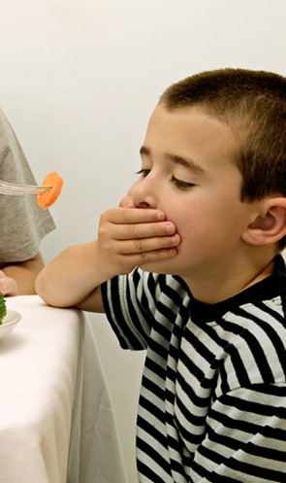
Social distinctions in food and eating
Eating is not driven by conscious decision-making or ‘freedom of choice’ - It is a result of habitus
We all develop an automatic, unconscious capacity to act in a way that is meaningful in our social context
Food, eating and ‘tastes’ – relate to cultural, social and economic capital
How does this underscore /reflect the reality of poverty, disadvantage or affluence?
Notes:
Eating is not driven by conscious decision-making or ‘freedom of choice’ - It is a result of habitus
We all develop an automatic, unconscious capacity to act in a way that is meaningful in our social context
Food, eating and ‘tastes’ – relate to cultural, social and economic capital - Cultural capital - value attached to culturally authorised tastes often more accessible to higher social classes; Social capital - ‘The resources linked to possession of a durable network of relationships of mutual recognition - membership in a group’ (Bourdieu, 1986, p. 51).
How does this underscore /reflect the reality of poverty, disadvantage or affluence?

Slide 7
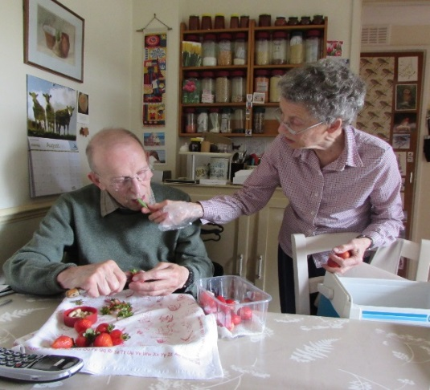
Lived experience in research - Taking a social practices approach
Food and eating are routine practices, shaped throughout the life course according to the social structures that underpin society
Practices have three interrelated components
  Competency [how do I do it?]
  Materiality [what do I need to do it?]
  Meanings [this is important to me because…]
Notes:
Explain this is how we tend to approach our research questions…
Food and eating are routine, embedded aspects of everyday life. Acquiring, preparing or eating food are part of an overall practice of ‘doing’ food, not rational, conscious or individual actions. Food and eating are tacit practices that are shaped throughout the life course according to the social structures that underpin society. having a ‘feel for the game’ when it comes to repeatedly getting, cooking or eating food according to social distinctions that are an ingrained part of the ‘way we live’. The action of buying food is one element of an intertwined set of knowledges, relationships, values, beliefs, resources and technologies that interconnect to form a food practice. This moves the focus of inquiry away from what an individual ‘does’ to make themselves vulnerable, towards an investigation of socially-defined food practices that allow a research team to analyse where vulnerability to food insecurity might begin or worsen.
Practices have three components - competency (the skills and know how that is drawn upon); materiality (objects and technologies that are used in the performance of the practice) and meanings (ideas, norms and symbolic meanings) (Shove 2012).
In earlier work, we explored how the performance of practices within the domestic kitchen could either protect or propel an older person towards vulnerability in terms of food-borne illness through increasing the risk of contact with pathogens such as campylobacter and listeria (Dickinson KL ref). We found that older people had a range of factors working against them that accumulated to make them vulnerability to foodborne illness in ways not evident for other household types so we set out in our latest study to look at this further.

Slide 8

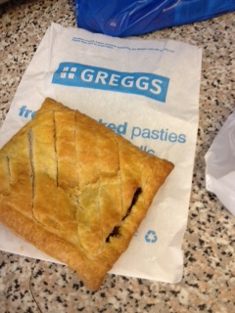
Functionality vs. form
The watson & Connell families
The Watson family – Dad works shifts in a manual job as well as working as a mini-cab driver; Mum works at a small food store/corner shop (4 days on; 4 days off). They live in social housing with their two adolescent children [Lorraine is obese according to her BMI; Mrs Watson says she herself weighs too much].
‘Normally either steak pie or an egg mayonnaise roll and a cream pancake. They’re my favourite. I like them and I only get them on a Saturday you know, if we’re having a baker’s lunch’ (Lorraine Watson, aged 13 years)
Notes:
The Watson family - Dad works shifts in a manual job as well as working as a mini-cab drive; Mum works at a small food store/corner shop (4 days on; 4 days off). The live in social housing with their two adolescent children [Lorraine is obese according to her BMI; Mrs Watson also says she weighs too much].
These two families reported quite different food practices and our analysis suggested money was not the sole reason for this.
The Watsons had food routines that focused on ensuring everyone got fed – there was plenty of food in the freezer; 13 year old Lorraine was encouraged to prepare food for her and her brother after school, when their mum was at work; Mrs Watson often cooked food in advance so everyone could reheat it when they needed to eat; they enjoyed what they called a ‘Bakers lunch’ on a Saturday, filled rolls or pies and cakes from the local bakers, which meant everyone could get on with chores and homework but they could still eat together. This family had food practices that enabled them to function and get by.

Slide 9
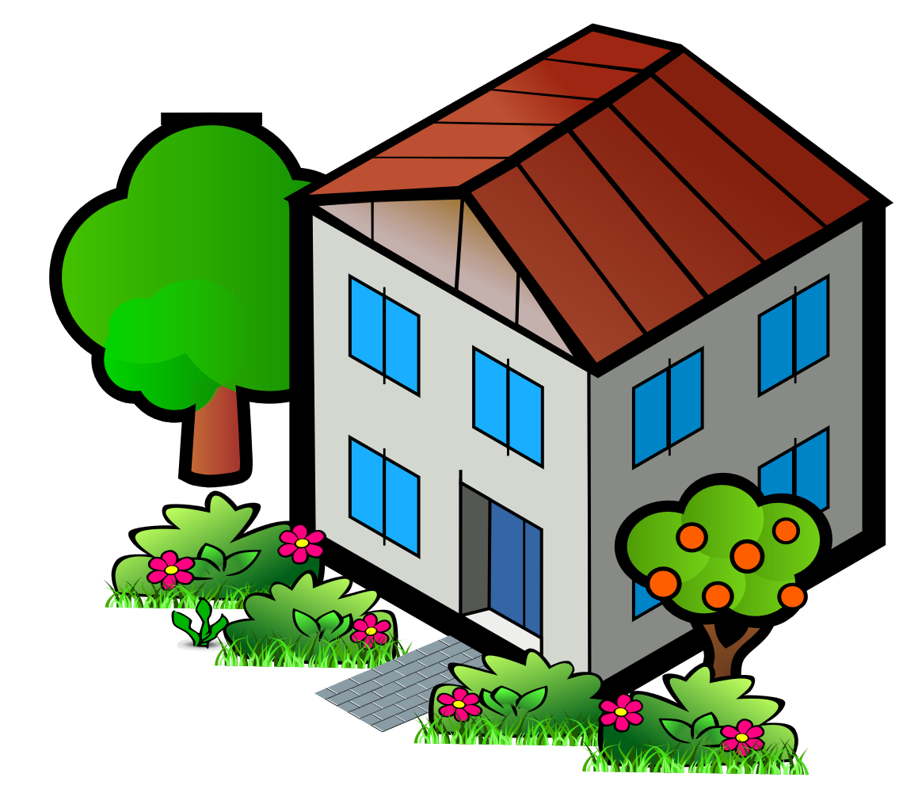

Functionality vs. form
The watson & Connell families
The Connell family – Dad works as an engineer; Mum is a solicitor. They own a large, detached house and have two adolescent children. All are/or report being a healthy weight.
‘I don’t like make a fuss [about vegetables] because I know I would get in trouble so I just …eat’. (Elspeth Connell, aged 13 years)
Notes:
The Connells reported eating as a family as the ‘norm’ for them and they prioritised this, the teenage children were not encouraged or indeed allowed to prepare their own food and could not take snacks without asking first; Mrs Connell wanted her family to eat a cosmopolitan diet, avoiding the traditional food from her own childhood. Health was prioritised and was something to aim at improving but also something to get anxious over.
Temporality was an important element to emerge from these lived experiences. The Watsons focused on the here and now, getting by, to enable life to flow as smoothly as possible. The Connells were firmly focused on the future, ensuring their children ate in a way that developed social capital, they proudly spoke about their daughter knowing how to eat in restaurants and insisted their children ate vegetables because they were good for them. Their daughter Elspeth reported her own guilt and anxiety about not achieving ‘good enough’ eating habits.
The autonomy of the Watson children was important, it was a marker of success because the children could feed themselves, cook for each other and were not considering ‘fussy’ about what they’d eat.
The Connells reported different markers of success, not having fussy eaters in this more middle class family related to children eating fruit and vegetables and being willing to avoid eating sweets or sugary drinks.
I wonder how many of you in the audience are thinking ‘Oh if only we get the Watsons to be more like the Connells’? Maybe if the Watsons didn’t eat a baker’s lunch every week, if only they prioritised eating fruit and vegetables rather than frozen or reheated food, if only they stopped the children from taking or making their own food when home alone.
The lived experiences of families like these illustrate what we’ve called the Hierarchies of Worry when it comes to food habits – when life is stable, when a good income is assured, parents can turn their thoughts to trying to shape their family’s eating habits with the aim of promoting good long term health [and authentic/sanctioned behaviours…]. When life is less certain, when you are worrying about your job or your marriage breaking down, or your daughter mixing with the wrong crowd or being excluded from school, then shaping the family eating habits, even when there are health conditions already in the mix, becomes much lower down the list of priorities. The worries are different.
It does not mean the Watsons don’t care about diet or about their daughter’s obesity. But it does mean that trying to change food practices in families like this is incredibly difficult, because the family operate within a system that is very much influenced by socio-economic boundaries. The social milieu in which the Watsons live compounds the feelings of success and achievement they have about getting by, their ‘feel for the game’ means they are doing well, there is no impetus to change and that is the power of exploring and trying to understand the lived experience, when seen in the light of socio-economic context rather than a context of ignorance and blame, it highlights why behaviour doesn’t easily shift. It also raises the question of the extent to which we can expect families to change their own eating habits when their agency is limited by the unequal structures surrounding them. I will come back to this later.

Slide 10
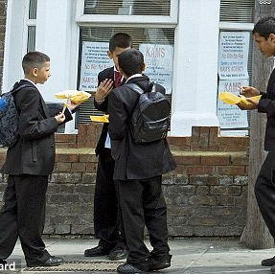
Social Inequalities in Health
Higher area-level deprivation linked with lower life expectancy and poorer health outcomes
Diets of households are further from achieving dietary goals as level of deprivation increases.
People living in households in more deprived areas consume fewer fruit and vegetables and spend less on those foods, than those in less deprived areas.
Higher deprivation linked with higher prices of fresh food
The role of PLACE is significant overall
Notes:
We know that there is a social gradient in health outcomes
Higher area-level deprivation linked with lower life expectancy and poorer health outcomes
Housing, employment, low income (in older age), smoking and diet are key factors
Diets of households are further from achieving dietary goals as level of deprivation increases.
People living in households in more deprived areas consume fewer fruit and vegetables and spend less on those foods, than those in less deprived areas.
Higher deprivation linked with higher prices of fresh food
The role of PLACE remains significant overall – so how does where you live, and the environment around you, your neighhourhood influence what you eat?
Young people from socioeconomically deprived backgrounds tend to have a poorer diet and higher rates of obesity and yet the evidence is not yet clear about why this inequality persists. If you visit schools that are getting it right in terms of food provision and environment you might also wonder why. But go to the schools I go to as part of research projects on food and drink within and beyond the school gate and I think the difficulties are right in front of you. The food and drink available to purchase during the school day and the environment in which it is sold and eaten is not a socioeconomically neutral issue.

Slide 11
The ‘Beyond the School Gate’ study
Food Standards Scotland [grant number FS411002]
Young people who participated:
Individual and group interviews = 50
Go-along lunchtime tours = 16
Focus groups = 155 in 14 F/G
Semi-structured written activity = 430
Online Purchasing Recall questionnaire = 535
Plus interviews with 6 School Heads, 7 School kitchen supervisors, 25 retailers.
Notes:
Seven case study schools were recruited from five different local authority areas across Scotland. The aim was to select schools that differed in terms of deprivation and food outlet density/type.
Typical of a case study design, the study used both qualitative and quantitative methods. Qualitative data were collected, through a variety of methods, Quantitative data were collected via an online food and drink purchasing recall questionnaire (PRQ) developed by the research team.
Qualitative methods included accompanied lunchtime ‘go-along’ tours with young people in the local food environment; observations of the school and local food environment; semi-structured written activities and focus groups in the classroom; and individual / group interviews with young people, retailers and school staff. Whilst the focus of fieldwork was the local food environment, it was useful to also undertake fieldwork and collect data about the school food environment as this helped to highlight why some young people elected to stay within the school whilst others venture outside to buy food or drink at lunchtime. We spent a period of approximately two weeks at each of the seven participating schools.
Using an online questionnaire enabled us to capture information on purchasing, together with the context of purchases, the amount spent and the importance of marketing initiatives that might influence purchasing habits.
The 25 retailers interviewed managed, owned or worked in a range of outlets including supermarkets and grocery stores; chain and independent bakeries, chain and independent takeaway outlets; independent cafes, food vans and leisure or community centres.

Slide 12
The lived experience of food in/near some of our schools
‘They kick us out early’; ‘ the café should be just for us’ [Young person]
In schools in areas of high socio-economic deprivation young people often want to ‘escape’ at lunchtime
  They don’t like to queue
  They feel the catering staff don’t understand their needs – to eat a small amount, quickly and to socialise with friends
  They feel prices and portions don’t offer value for money
In contrast, local retailers in higher deprivation areas are welcoming, understand young people’s needs and offer value for money food and drink
“Yeah, so we usually know what they’re after so we’ll prepare it all before they come in so that we don’t run out” (Bakery)
“…every customer’s important to me …so if you treat them [pupils] with respect generally they’re okay” (Newsagent)
Notes:
The social nature of lunchtime and the importance of the peer context
Schools were sometimes seen as being anti-social, with the school dining environment seen as a barrier to spending time with friends. Staff sometimes closed the door to the dining hall to discourage pupils from coming inside to spend time there after the initial lunchtime rush and some staff started clearing the tables and cleaning floors whilst young people were chatting to their friends after eating lunch. Comments such as ‘they kick us out early’; ‘ the café should be just for us’ (Sch01; high dep/mod food) were typical from pupils at schools perceived to be unwelcoming and some catering staff were described as ‘grumpy’ (Sch01; high dep/mod food). Some pupils reported sitting and eating lunch in the corridors as an alternative to the main dining area though this meant some got ‘screamed’ at (Sch04; mix dep/mod food). Overwhelmingly such schools tend to be in the most socio-economically deprived areas.
The external food environment in poorer areas was usually perceived as somewhere that young people wanted to spend time with their friends. Retailers were rarely reported to push young people out after they made a purchase so they could ‘take their time’ (young person at Sch01; high dep/mod food), often with different members of a friendship group purchasing at different outlets whilst their friends waited for them. Once everyone had purchased what they wanted to the group often stood around the local shops eating and drinking, or they took a slow walk back to school whilst they ate, drank and socialised. At one local fish and chip shop close to Sch04 pupils were observed sitting in a circle on the floor of the outlet after the lunchtime rush had subsided; the owner said he was happy to accommodate this. Some outlets offered seating areas but these were rarely used by young people, as they were often not big enough to accommodate a peer group.
The pull of the external food environment
In contrast to many schools, retailers spoke about their knowledge of young people’s food and drink preferences and the way they tailored what they offered to the young people who lived locally. This included ice cream vans selling individual sweets at a very low price and pouring boiling water onto pot-type noodles so they were ready for pupils to eat; retailers getting orders ready for young people to collect and, for one small sandwich shop close to Sch01, offering an SMS text ordering service for young people. In the external food environment some retailers observed young people trying to make healthier choices, particularly as they got older and particularly if they were female and some tried to build on this by offering healthier options in store (more salad choices, for example, or more sandwich fillings perceived by retailers to be healthy). Some retailers also observed what young people frequently purchased and then made or stocked similar products to tempt them to purchase alternative items. Most retailers tried hard to ensure that they had enough of the foods/drinks available that young people preferred:
“Yeah, so we usually know what they’re after so we’ll prepare it all before they come in so that we don’t run out” (Interview with bakery staff, Sch06; low dep/ low food)
“…we just actually listen to what they’re asking for and just try to accommodate to the best of our ability, if they’re saying, likes of when we first started doing the chicken tikka it was what can we bring into the mix that the young ones would like and we actually asked the kids themselves, it was a wee bit of market research, and just checked to see what flavours they would like, and we’ve tried out quite a few different ones…” (Interview with leisure centre café employee, Sch02; high dep/ low food)
Retailers in the vicinity of the schools we studied often discounted their prices during the lunch period, bringing prices down to levels that were more in line with the money that young people had to spend or selling cheaper options only at lunchtime (chips and beans for example, was offered at lunchtime near Sch04 for £1.50). Many young people said they were not offered discounts, as these promotional lunchtime prices were considered by most to be the normal price.

Slide 13
Free School Meals
‘if [parents] work it’s not fair, it doesn’t mean they can afford it’ [young person]
Pupils discussed lack of fairness about whether their family was eligible for FSM
Working parents were viewed as being penalised if earning above the threshold that related to FSM eligibility
Stigma about free school meals is still a barrier
‘If they do get free school meals, then they don’t get any money, but then they’ll be hungry by
Break…and they can’t
get both’ [young person]
Notes:
It’s interesting and distressing to hear young people talk about the injustice and inequality their families face because they are poor yet not poor enough to qualify for free school meals, to hear teenagers say they don’t feel welcome in their own school, that school isn’t a safe or comfortable place to eat lunch and socialise with friends, that the food and drink sold in their school is poor value, unaffordable and of low quality. Whereas when they shop on the high street around their school they experience a warm, welcoming environment. They can purchase very low cost food that suits their needs. We have found in our research that young people do not want to eat a meal at lunchtime, they want to eat just enough food to fill them up that costs the least amount of money. In schools where they can go outside the gates at lunchtime, in Scotland for example, we’ve found that up to 90% of young people at the most socio-economically deprived schools go outside to buy their lunch. It’s no wonder that a bag of chips is an attractive option because gives young people a chance to escape an environment that’s perceived as unwelcoming and only sells chips if it’s part of a meal, at a cost that’s viewed as prohibitive.

Slide 14
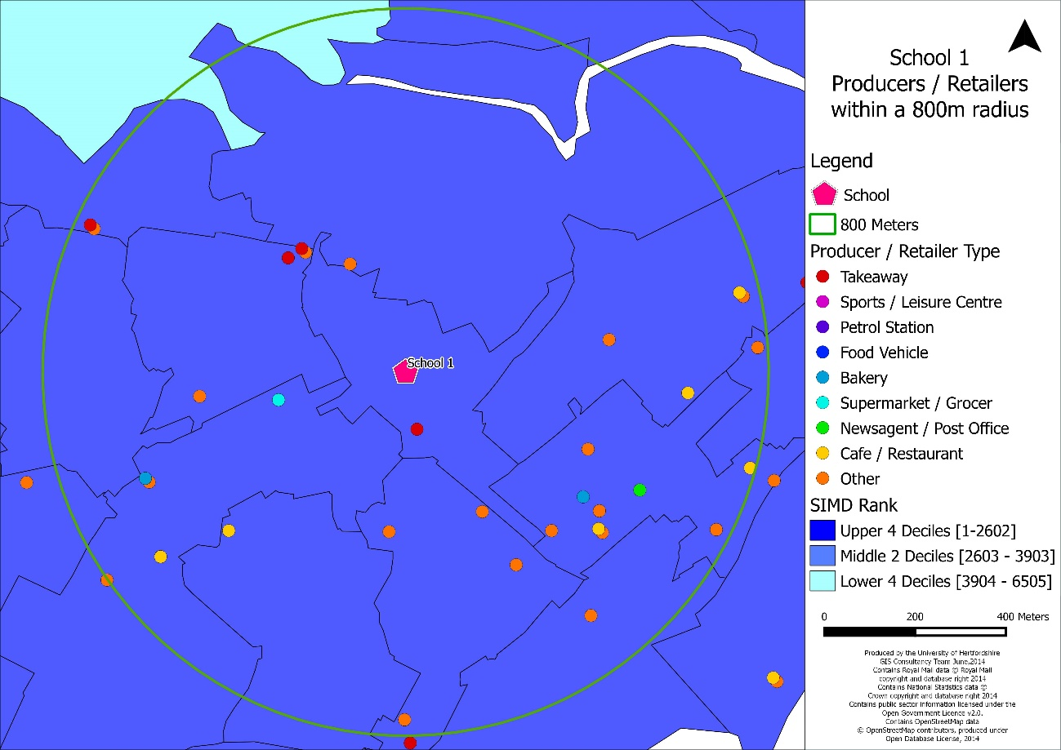
The lived experience of ‘place’
Notes:
These schools had the same number of food outlets within an 800 metre radius [10 min walk], - between 20-99 – and both had a higher than average % of pupils in receipt of FSM. Yet at the school on the right more than 90% of pupils told us they left school at lunchtime at least twice each week compared with less than 80% leaving this often at the other school. Pupils at sch1 on the left purchased more often from takeaway outlets and pupils at sch4 on the right went to supermarkets – even though the number of such outlets was similar by each school. The school on the left had high levels of multiple deprivation yet it was pupils at the school on the right who were more likely to report price being a driving factor in their purchasing decisions.
Young people at the more deprived school on the left had very good relationships with retailers and really didn’t like the physical or social environment within school. Pupils at the less deprived school [but high FSM…so many YP were from low income families] felt excluded from many of the food outlets locally, particularly the ones offering healthier choices e.g. offers on fruit.
So the lived experience of going to school in an area categorised as socioeconomically deprived is nuanced, price, type of food outlets near a school, social interactions, all differentially influenced where YP shopped and therefore what they ate.
This can be further illustrated through reference to research on older people and how they get food as they get older. It was crystal clear from this research that social networks and the local food environment were vital for ensuring that older people did not become vulnerable to malnutrition or food insecurity. We estimate that 1 in 10 people aged over 65 are malnourished or at risk of malnutrition in the UK, they simply aren’t accessing or eating sufficient food or nutritious food to maintain good health and wellbeing

Slide 15
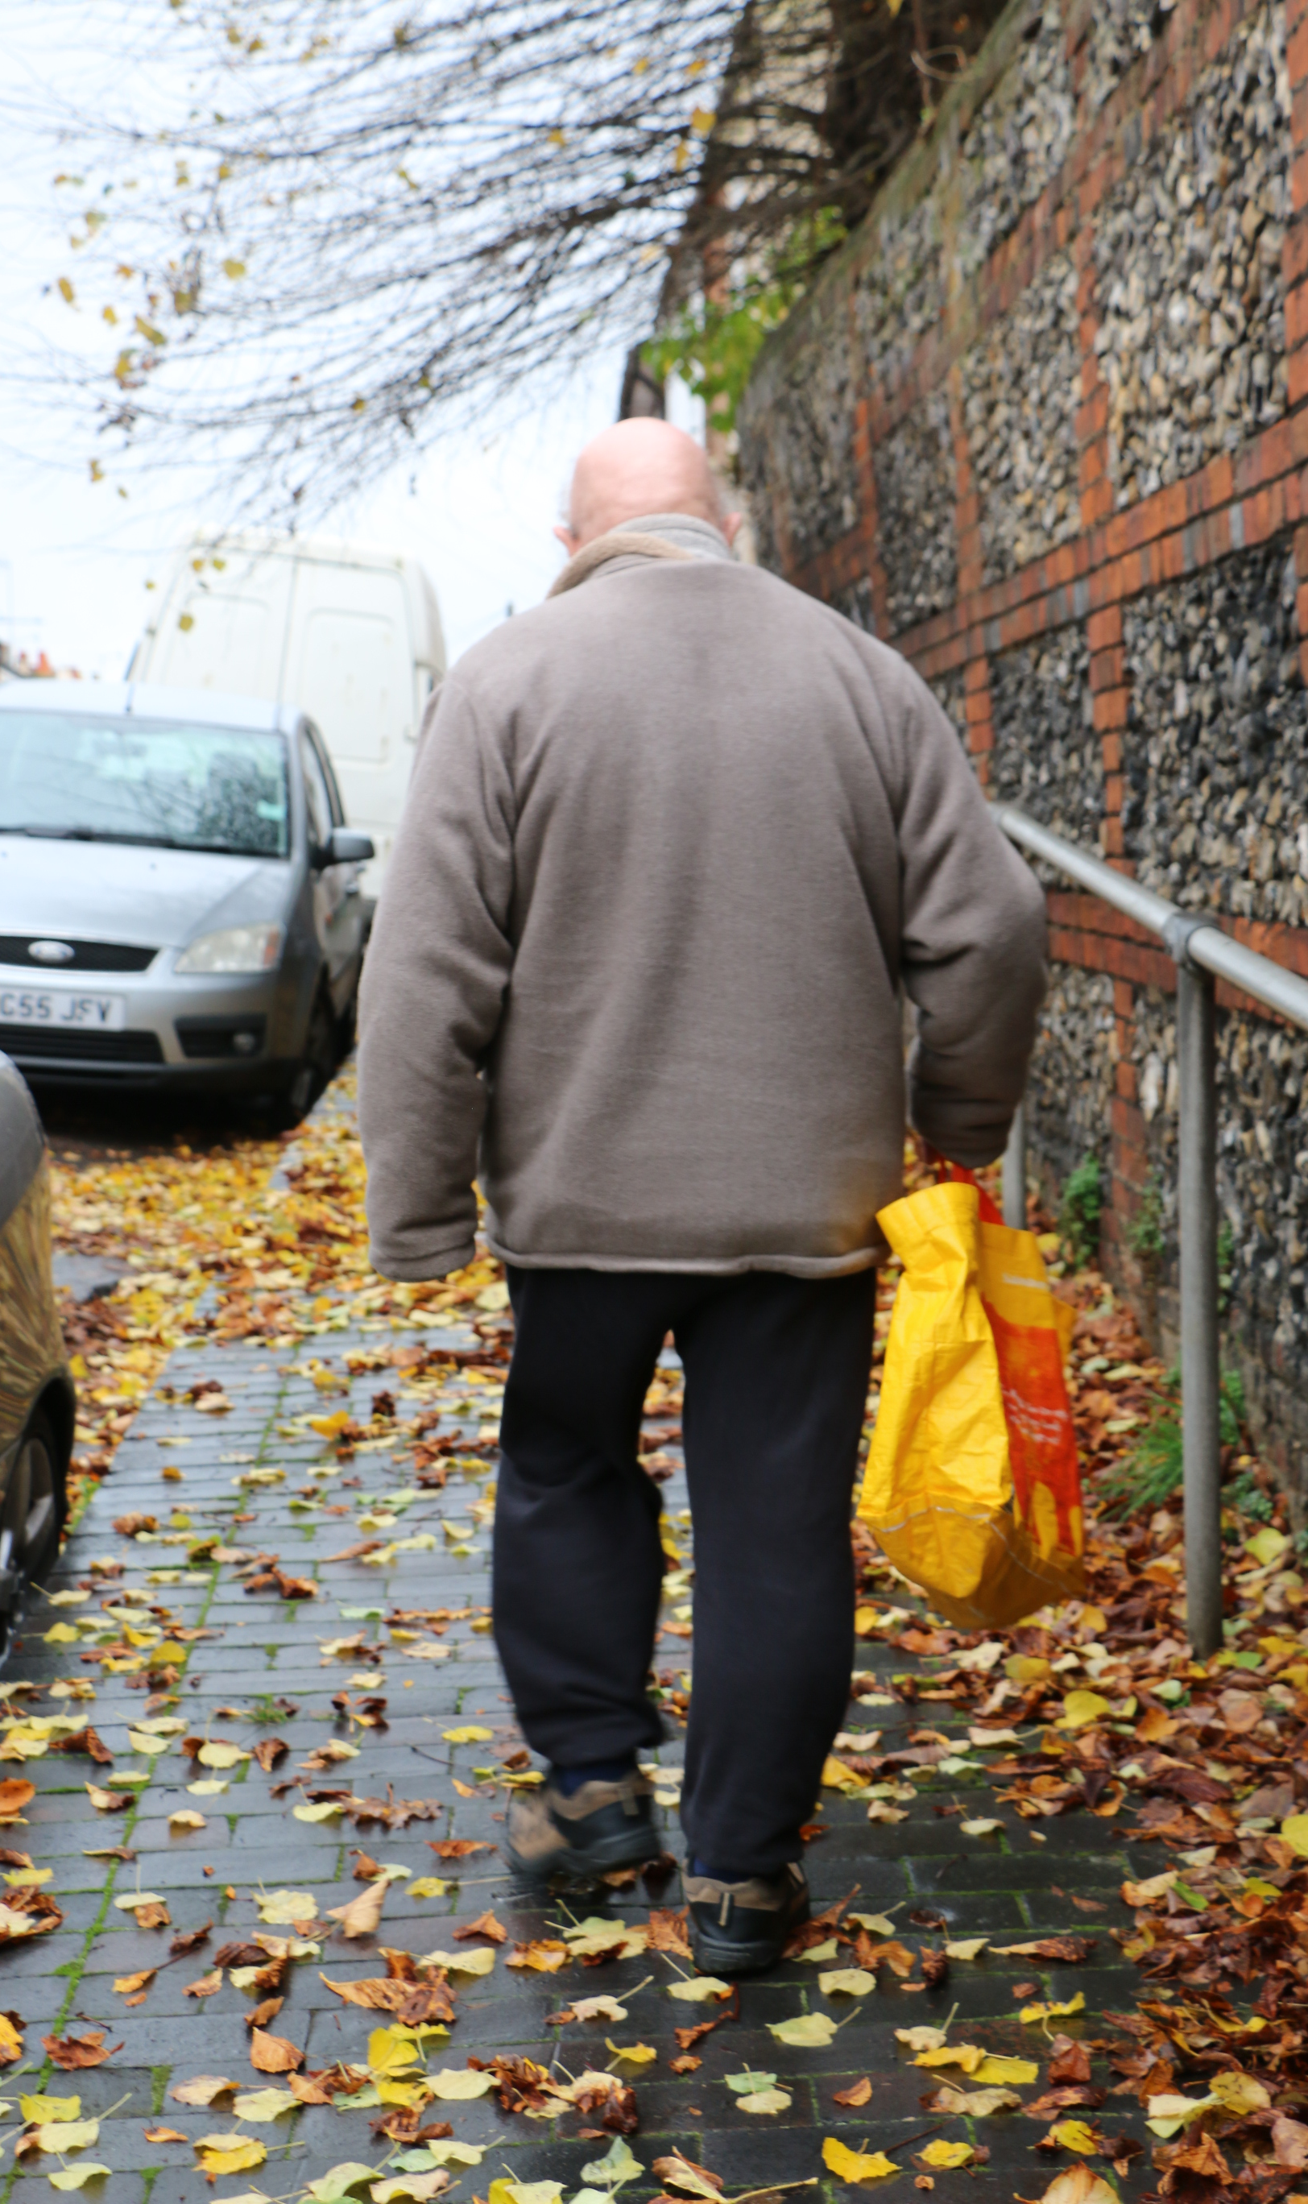


The Food in Later Life study
25 households aged 60-95 resident in the East of England
2 to 5 visits to each household
Ethnographic approach using video, photo elicitation, interviews, food logs and ‘go-along’ tours
Data analysed using interpretative engagement approach
Notes:
Research funding from ESRC and FSA as part of a programme of work addressing challenges within the UK food system.
Drawing on our previous work for the FSA on domestic kitchen practices:
Qualitative, ethnographic approach: This research is based on the everyday practices of 25 households aged 60-95 resident in the East of England. The premise of the research was to explore how such households managed food security activities including cooking, shopping, growing food and other food-related activities within and outside the home.
The 25 households reflected a diverse demographic mix, with a cross-section of ages, gender, living status, residential area, ethnic origin and different means of transport. All were sampled purposively and recruited via lunch clubs, relevant networks, sheltered housing units and the researchers’ professional networks. Data were collected by four researchers over 11 months. 79 separate visits were conducted across the 25 households and 32 older people within these households were interviewed.
25 households with people aged 60-95 years
2 to 5 visits to each household in 2015
Data collection: Video, photos, interviews, food logs and ‘go-alongs’
Participants were offered a disposable camera to capture their food provisioning habits and 7 agreed to use it. participants gave a tour of their kitchen and other house areas where food was stored, prepared or grown (e.g. gardens and sheds) took place (Arsel and Bean 2012; Epp and Price 2009). Photographs and videos (using Go-pro wearable cameras) were captured by researchers to further illustrate and record points raised during interviews and observation (Cannuscio et al. 2009).
Most second visits included joining participants on food provisioning trips, either to shops (19 households) or to their allotments (2 households), recorded using a GoPro camera worn by the researcher or participant. Second visits also included commented observationsa recorded interview or discussion of activities such as looking through frozen food delivery menus, attending coffee mornings and observing carers preparing meals . Third and fourth visits included further interviews while looking at videos/photographs captured by the participant and/or the researcher. These interviews enabled more in-depth exploration of participants’ food security practices Wasn’t aware we did this…
We didn’t- because of consent for carers
42 interview transcripts,
1,290 photographs
Nearly 30 hours of filming
20 food log/household notes
In total, the ethnographic data collection resulted in 50 interview transcripts, 1,270 photographs, 22hrs 51mins of filming, 20 food log/household notes and 25 fieldnotes. All participants shopped at one or more supermarkets,
11 attended a luncheon club
9 had some form of food delivery (Family delivered meals, meals on wheels services, Wiltshire farm foods and milk man)
2 regularly also patronised farmers market
2 participants had one or more carers who also helped to shop for and prepare food and
none of our households shopped for food online
Interview transcripts, food logs, fieldnotes, photographs and video footage were analysed in parallel, with iterative cross-referencing of emerging themes. Researchers wrote analytical notes about the photographs and videos and all the textual data were imported into NVivo 11. Inductive coding was then undertaken, with codes being discussed by the research team to achieve agreement. We call this process interpretative engagement.

Slide 16
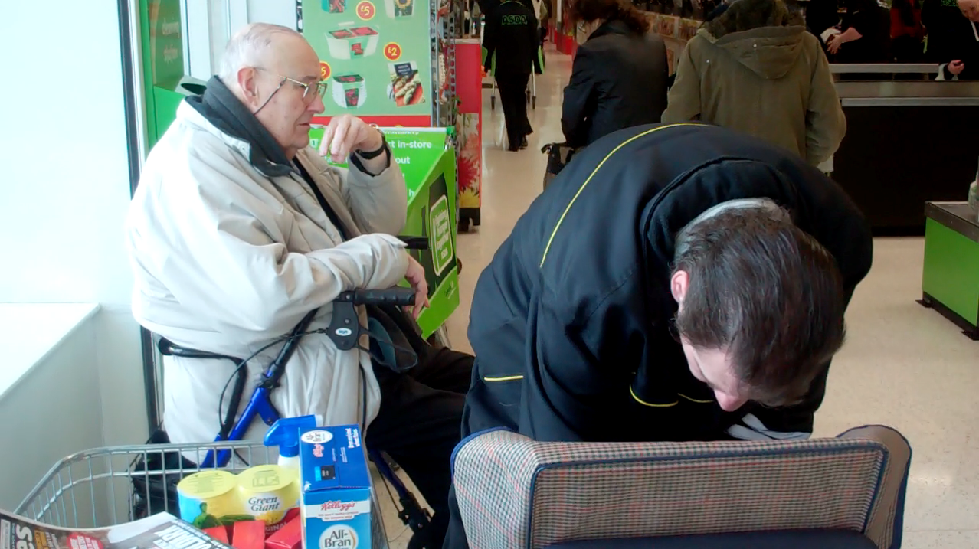
Food practices: threats, assets and adjustments -
The case of Dexter
Notes:
we found when analyzing the data, that older people’s food practices are entangled and highlight that they are not linear but connected, so it’s important to consider the broader system within which people acquire food, and the reasons behind their decisions to shop at particular supermarkets if we are to make older people more food secure as they age.
Older people made a number of adjustments, in response to repeated and multiple threats to their ability to get and prepare food and that they drew on a number of really important assets too.
One of the main features of the data was the cumulative nature of the threats found to be operating both within and external to households in later life. In order to demonstrate some of this complexity and illustrate the entangledness, I am going to talk about a man we call Dexter.
Dexter lives on his own in a ground-floor, rented sheltered housing flat that he moved to some years ago to be nearer to his sister. Before he retired he enjoyed driving and worked as a chauffeur, but has given up driving due to his deteriorating vision following onset of macular degeneration (threat). His health problems have had a major impact on Dexter’s food related practices and habitus. He has a number of health problems, including cardiovascular disease and about five months prior to the study ‘go-along’, he fell and damaged his knee (threat). Following a stay in hospital, he became housebound and reported feeling lonely (threat). His declining eyesight affects practical aspects of his food practices such as shopping; specifically, finding the food he wants to buy on the supermarket shelf is difficult, and without a magnifying glass he cannot read the labels.
…many a time I pick something up, got it home I thought “what’s this?” and I get me magnifying glass, “oh I don’t want this”. So that’s why I, you know, get somebody to come with me now. I can’t see what I’m picking up now so therefore I, you know, see what annoys me is with these supermarkets first of all you go in a supermarket, it’s there same map and everything so alright, I can pick that up, no trouble at all, but then they move it…course then it takes me half an hour to get one item.
Dexter has drawn on a number of assets to support a range of adjustments. He has drawn on his know-how to contact a local charity that helped him find a carer (adjustment). Jason, visits 3-4 times per week to help him with shopping and cooking, but plays an important social role (asset) and their friendship has developed as they share a number of interests.
Dexter used to travel to his preferred supermarket where ‘the staff are more friendly’, by bus and he had a good relationship with one of the checkout staff. He cannot manage the step onto the bus (threat), so now shops at a local supermarket, walking there with Jason (adjustment); but it is not where he would choose to shop (threat). He worries what might happen if he falls again (threat). Video of Dexter shows him being forced to walk in the road as cars were parked on the footpath (threat). Dexter shops on Wednesdays as it is quieter, so he doesn’t get ‘knocked about’ as much (adjustment). ‘If you go on a Friday you get pushed and shoved and…I just got fed up with that’. He describes the shop as an obstacle course (threat).
there are people who love to have a chatter in the middle of the aisle and put the trolleys that way so you can’t get past and it’s like an obstacle course sometimes.
This is supported by the video as we observed him being steered around numerous obstructions in the aisles by Jason (adjustment). His walking aid with a seat enables him to rest at points around the store (adjustment). On the ‘go-along’ he sat down while waiting at the till and as Jason packed the shopping into the wheel-along shopping trolley.
Jason helps with finding the foods that Dexter wants to buy, checking package information (Dexter is particularly conscious of sell-by-dates and will not eat anything that has gone out-of-date), helping at the till and packing food into the trolley (adjustment). Dexter feels he lacks agency to change things (threat). He felt it was a waste of time to talk to managers or to write and complain about his experiences of poor customer service (threat) ‘there’s no point… Nothing gets done, it’s still the same’.
Within his home Dexter enjoys cooking, however, this now presents challenges due to his limited eyesight and inability to stand for long periods (threat). He has cut himself several times, so has changed his practices and now buys sliced bread and frozen vegetables to avoid the need to use sharp knives (adjustment). The foods in his cupboards are carefully organised and he has markers on the dial of his microwave, and has a chair in the kitchen so he can rest (adjustments). A major change in food practices relates to eating and entertaining with food. He used to enjoy hosting dinner parties for friends but is no longer able to do this (threat). He still cooks a roast dinner, using left over meat to make sandwiches. One of Dexter’s practices is to cook soups that he then stores in his fridge or freezer to use later (asset).
Dexter tried meals-on-wheels when he came home from hospital, but didn’t like the food. He attends a lunch club locally (assets), originally to make friends. However, some of the people who attend bring alcohol and drink all afternoon, which Dexter is uncomfortable with (threat).

Slide 17
Threats, assets and adjustments:
The case of Dexter
Threats: Macular degeneration, injured knee, housebound, loneliness, unable to use the bus now, had to change where he shops, worries about falling, pavements=trip hazard, supermarket obstacles=trip hazard, poor customer service, unable to stand for long
Adjustments: charity befriender/carer, walks to the shops with his carer, shops when it’s quieter, carer helps him around the store, walking aid with a seat, seat in the kitchen to rest on, sliced bread and frozen veg to avoid using a sharp knife
Assets: new friendship, batch cooks/freezes food, attends lunch club
Notes:
Through exploring one case study in detail, we can see how a number of threats, major (eyesight and mobility) and minor (eg lack of seating at the supermarket) appear to be constantly challenging Dexter to respond. It is possible to see how these threats, because of their number, and their seemingly constant onslaught, could have accumulated without resolution and moved him towards food insecurity. Some of the adjustments made, although appearing to address the challenge, were at the expense of aspects of his well-being, for example, although he is still able to obtain food- it is not from where he would like to shop, he has lost an important part of his social network as he is no longer able to engage in the fun and banter with the shop assistant he had built a relationship with. He is no longer able to host his dinner parties, though some of this social enjoyment is replaced by sharing his meals with Jason and attending the lunch club, for Dexter there is still a sense of loss. The adjustments are therefore partial in terms of supporting him.
These challenges were not unique to Dexter, for example, many of the ‘go-alongs’, showed supermarket aisles filled with obstacles such as people stopping to chat, trolleys, and other items left on the floor, as well as pavements blocked with cars, covered with wet slippery leaves and other hazards.

Slide 18
How can public health policy/ practice use lived experience ?
Take inspiration from: @jimmcmanusph @felly500 @andykturner
Notes:
There is a lot to consider or that I could say here so I will keep to 4 key points. I’m drawing inspiration from two fantastic Directors of Public Health, Jim McManus from Hertfordshire and Greg Fell from Sheffield, both of whom write excellent blogs that I recommend you look at, plus Andy Turner who is PH Specialty Registrar, Cumbria and Lancashire and who writes on Greg’s blog page. You can find them all easily through Google or on Twitter. If you look at the outputs and musings of many Dir of PH in this country you will see that they have great insights into the importance of wider determinants of health and wellbeing, they hold the answers but are themselves constrained and frustrated by dwindling public health budgets and lack of commitment by central govt in terms of the prevention agenda, despite this being a central tenet of the NHS forward plan in relation to secondary prevention and Sustainability and Transformation Partnerships stating that prevention must be prioritised at local level.

Slide 19
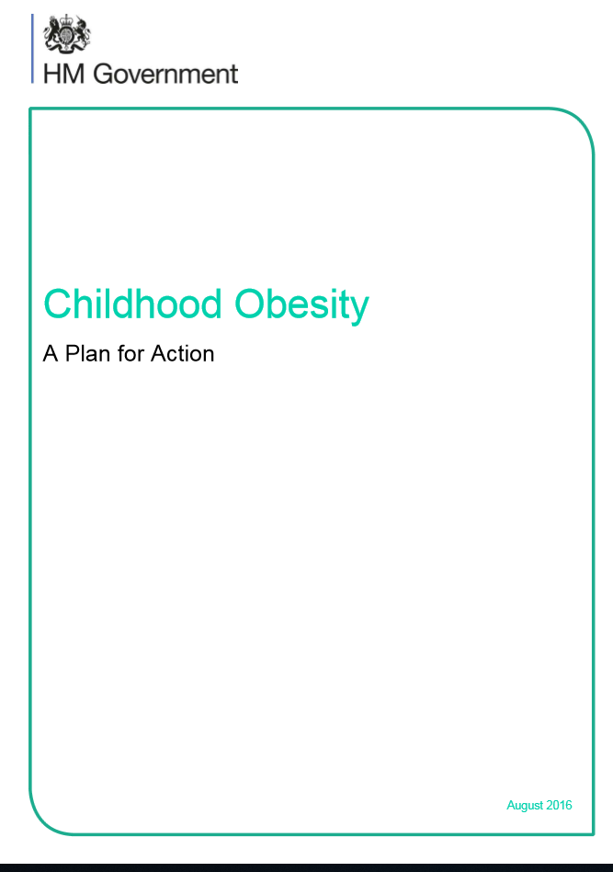
#1 Avoid ‘lifestyle drift’
‘Consumer power and choices are important drivers of the food environment and, potentially, in ending the childhood obesity crisis. We need accessible, simple information on how much sugar, fat and salt your weekly shop contains. We need to capitalise on the power of technology to support healthier choices. The uptake of Change4Life’s Sugar Smart app31 shows the potential of digital applications in this regard. We will therefore work with PHE, Innovate UK, the third sector and commercial players to investigate opportunities to bring forward a suite of applications that enable consumers to make the best use of technology and data to inform eating decisions. We will also ask PHE to build on work which is underway around digital based weight management support for adults and explore similar approaches for children and families’ [emphasis added]
Notes:
It’s essential we see lived experience as evidence of population level issues with food and eating practices, there is a tendency for ‘lifestyle drift’ when it comes to policy approaches, that despite an intention to take account of social determinants of health or wellbeing the solution drifts down to one that focuses on lifestyle, at the individual level. When I talked about the Watson family earlier, I said the ‘easy’ response might be to think how can we get Mrs Watson to provide healthier food for her family – a similar ‘lifestyle drift’ response is the Govt Obesity Action Plan, Chapter 1 where it boldly states that the Govt will help shoppers to shop smarter using a Change4Life’s Sugar Smart app – whilst I’m taking this in isolation, this example alone highlights the individual focused language of this solution, it’s hard to read this in any other way than you are responsible for what you buy without contextualising the information with the broader determinants we know influence what food we all buy.

Slide 20
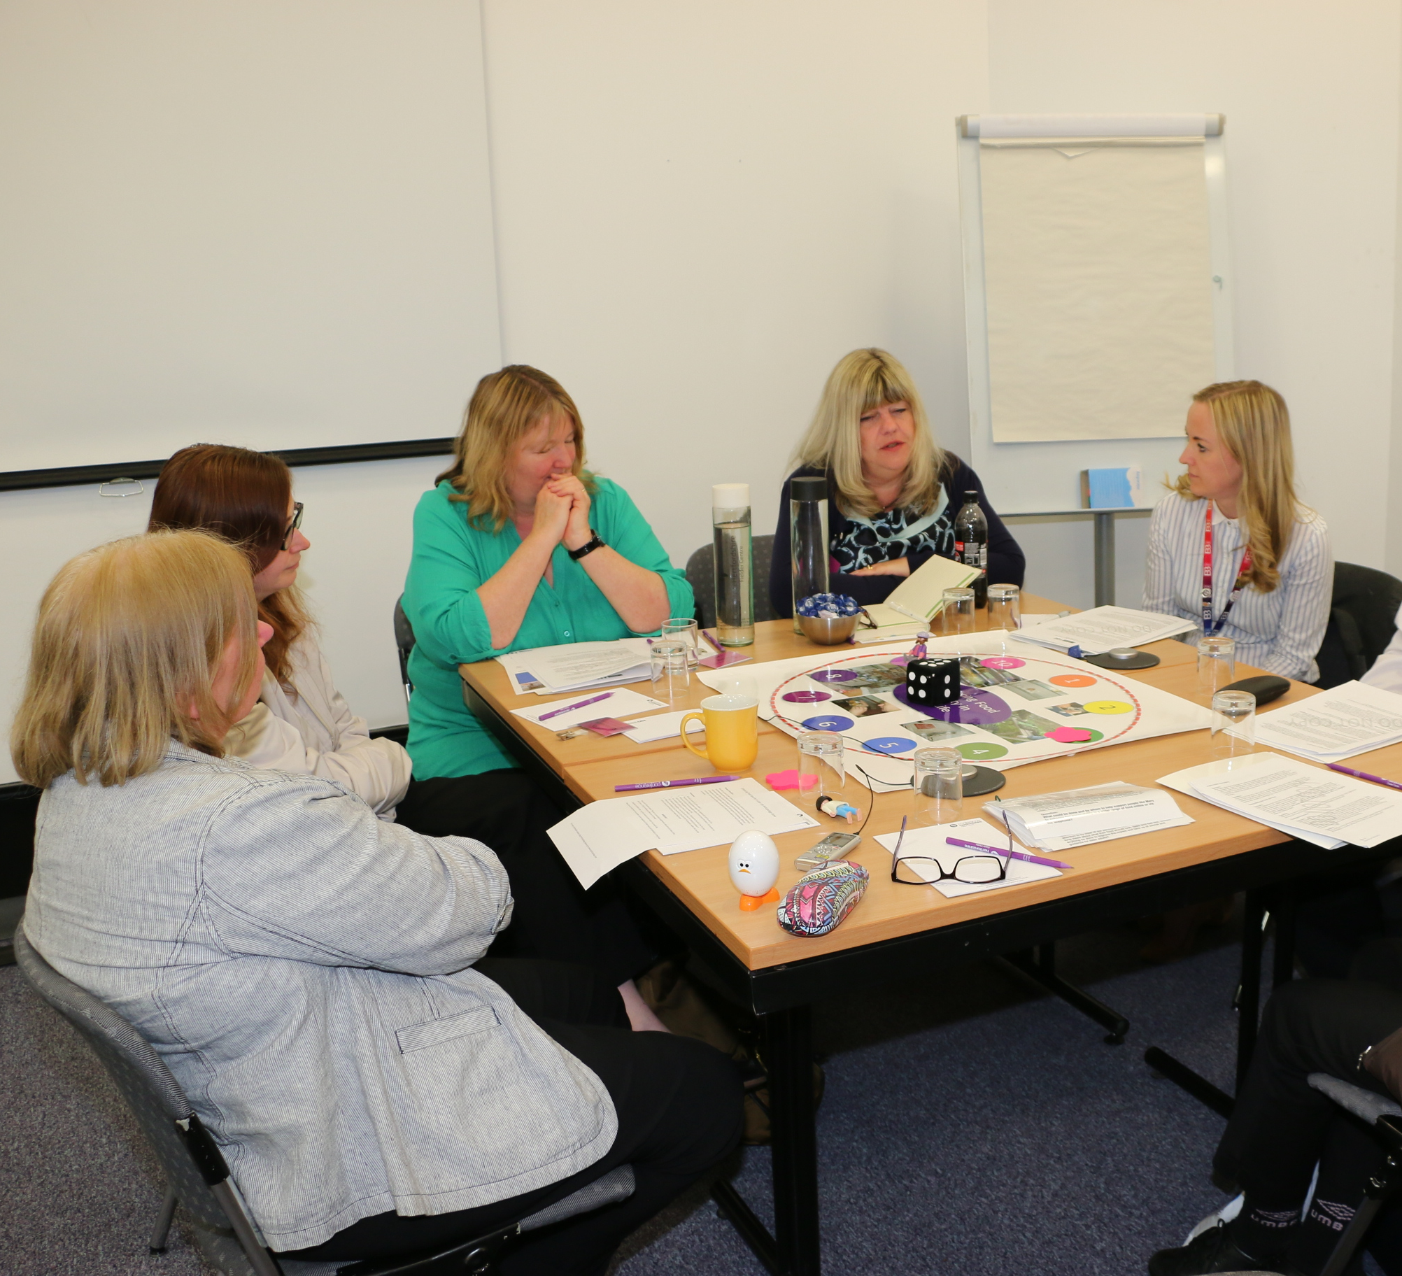
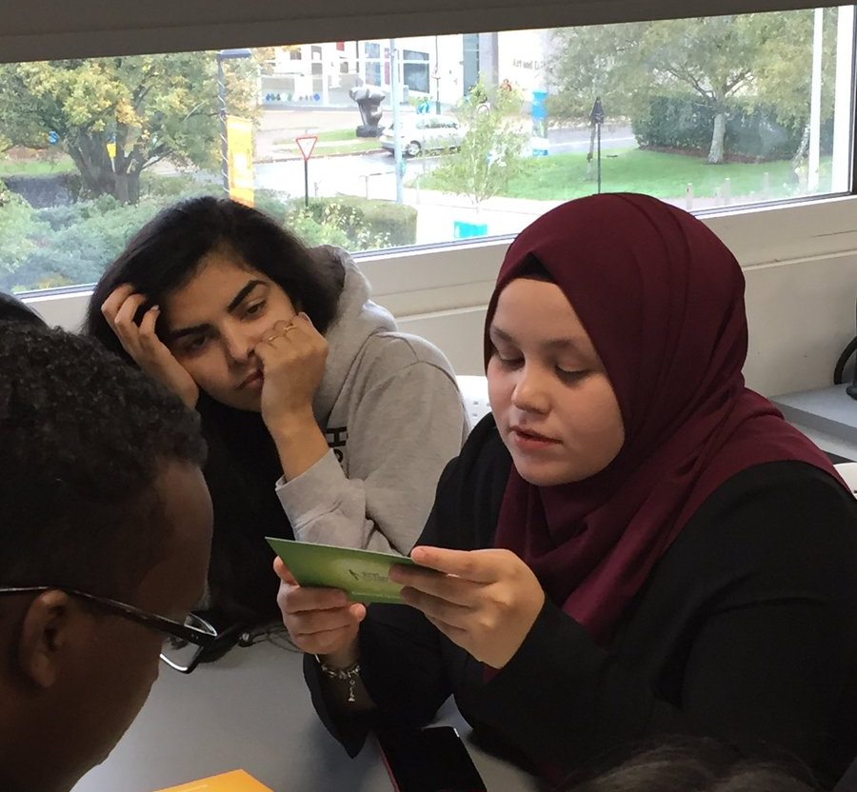
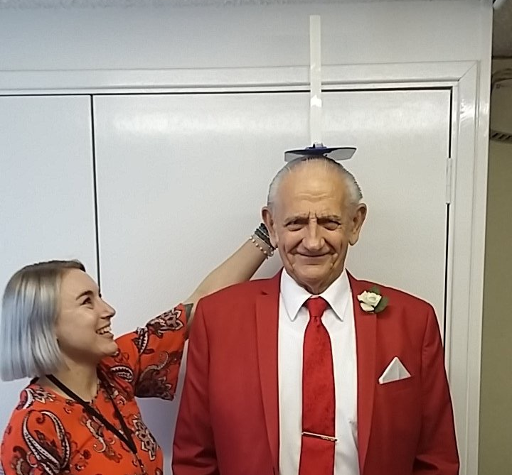
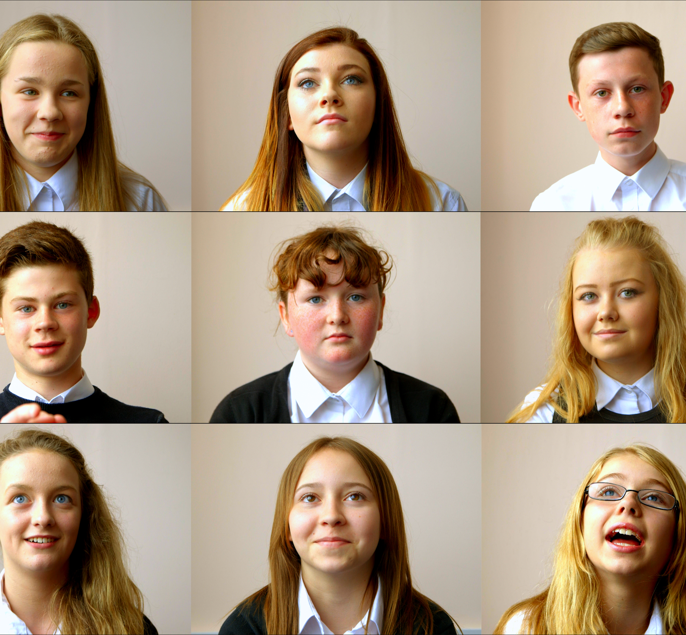
#2 Involve people with lived experience of obesity, malnutrition and hunger in public health processes
Do ‘with’ not ‘to’…
Notes:
… that we involve people with lived experience at every stage of commissioning programmes; developing policies; designing research; evaluating interventions.
We have a strong tradition in the UK of patient and public involvement, PPI, it’s not, however, universally acknowledged that people with experience of a situation or condition are best placed to help us find solutions to it. Involving people is messy, it’s time consuming, it’s expensive, is it really worth it, or just tokenistic and a ‘nice to have’? It is fundamentally important that we involve communities in designing neighbourhoods, and workplaces, and schools etc that improve the primary prevention of diet or influence food related conditions like malnutrition, obesity and hunger. Any system that does not do this is flawed and should not be publicly funded. We should enable communities, academics, public health specialists etc to call out any process that is not taking account of lived experience. We need to embolden those who make policies at national or local level to have confidence in lived experience, including research evidence that is qualitative, rather than to shy away from this form of evidence.
Any evaluation of a policy or intervention that is not properly funded and does not include time for seeking the views of the communities it’s seeking to govern or change will be inadequate [give Essex example…].

Slide 21
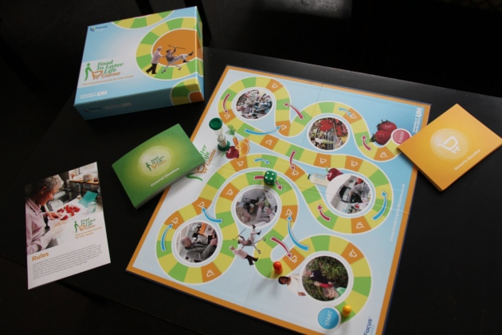
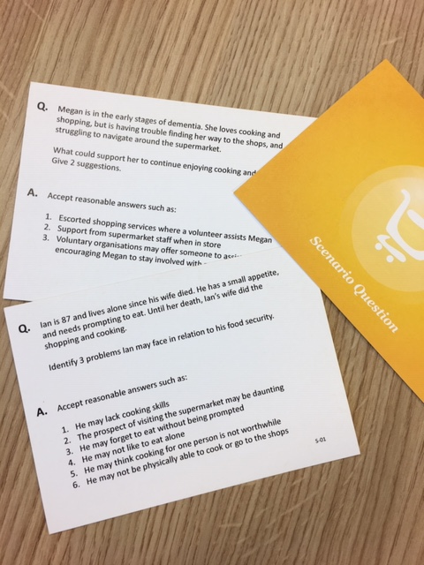
#3 We need better arguments not better evidence
Foodinlaterlifegame.co.uk
Notes:
3) We need better arguments not better evidence [Andy Turner’s guest blog on Greg Fell’s site]
Andy Turner points out that we will never have incontrovertible evidence that an approach is guaranteed to work, or not work, we need to go with approaches where the probability of it working outweighs the cost. Those using public health evidence have their OWN lived experience, their public health practice draws on their own beliefs and values as much as it does on survey data. As academics I’m sure many of us feel we can’t over-state the findings from our research, but in fact we are losing out by taking this approach. Boldly stating that older people will increasingly struggle to get food if we don’t create a social network that supports them, or that young people continue to be stigmatised at school because of their parent’s poverty is not mis-representing my research, it’s just using language that is bolder than I would use in a journal article. Let’s get over that reticence and make better use of our research endeavours.
We must use lived experience about food and eating in a way that cannot be ignored, we need to do this repeatedly – in my experience policymakers DO listen to lived experience, they themselves have an emotional response to it, this response must be harnessed and repeated, we should not allow our policy colleagues ‘off the hook’, we have to find ways to help them to develop policies and programmes that tap into the richness of what populations are experiencing. Lived experience must be part of the toolkit of evidence that is used to create change. In addition we need to walk in others’ shoes – not everyone will ‘believe’ that parents of overweight children have a complex social system that informs their child’s weight; not all members of the public will think there are people who are malnourished or hungry – we should not dismiss these perspectives but try better to understand and then counter them. Creating anger, a movement of dissatisfaction can be a powerful thing. Look at the People’s March about Brexit last week, we need to harness such an emotional response about the way social systems are failing people in relation to how they eat and then use this response for improving population health.
On the screen is a picture of an educational game we’ve just launched called the food in later life game. It’s based on our research findings, focus groups with stakeholders from public health, the third sector and the commercial sector and pilot testing with dietitians and students, the game forces those who play it to walk in others’s shoes, to consider the pros and cons of taking action to improve the food security of older people, we use scenarios based on real people’s lives to highlight the complexity of the food system in later life and the response from those who have played it so far has shown that this kind of approach, that’s discursive and participatory and based on lived experience really might help to bring about change. For example it gets people discussing the pros and cons of ready meals for older people – who might gain from having a hot meal but miss out nutritionally or on social interaction from a visit to the shops, players have to consider what other interventions are needed at an individual level but also at local or national level, what services need to be strengthened, how are details communicated. I’m using this as an example of how we might create better arguments, drawing from lived experience to create a strong impetus for improving public health.
Drawing on lived experience isn’t tokenistic or a ‘nice to do’, it’s an essential element of understanding how to improve population health through addressing obesity, hunger and malnutrition and other issues that relate to food and eating.

Slide 22
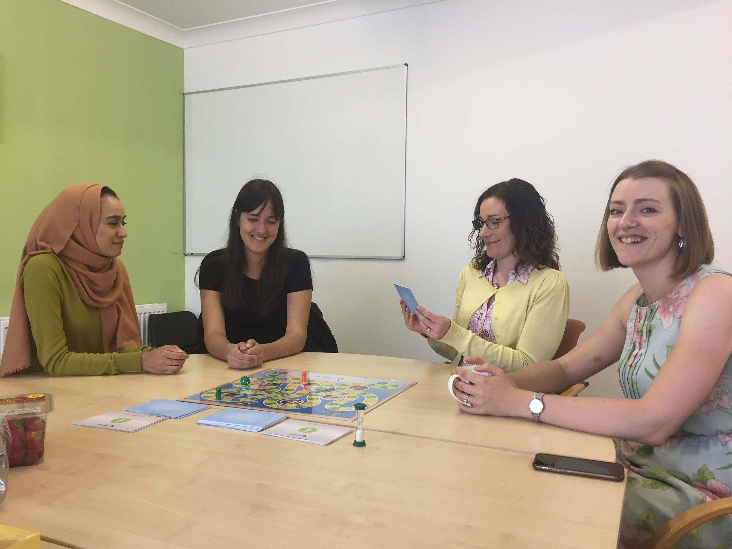

Foodinlaterlife.co.uk
Approved training resource:

Slide 23
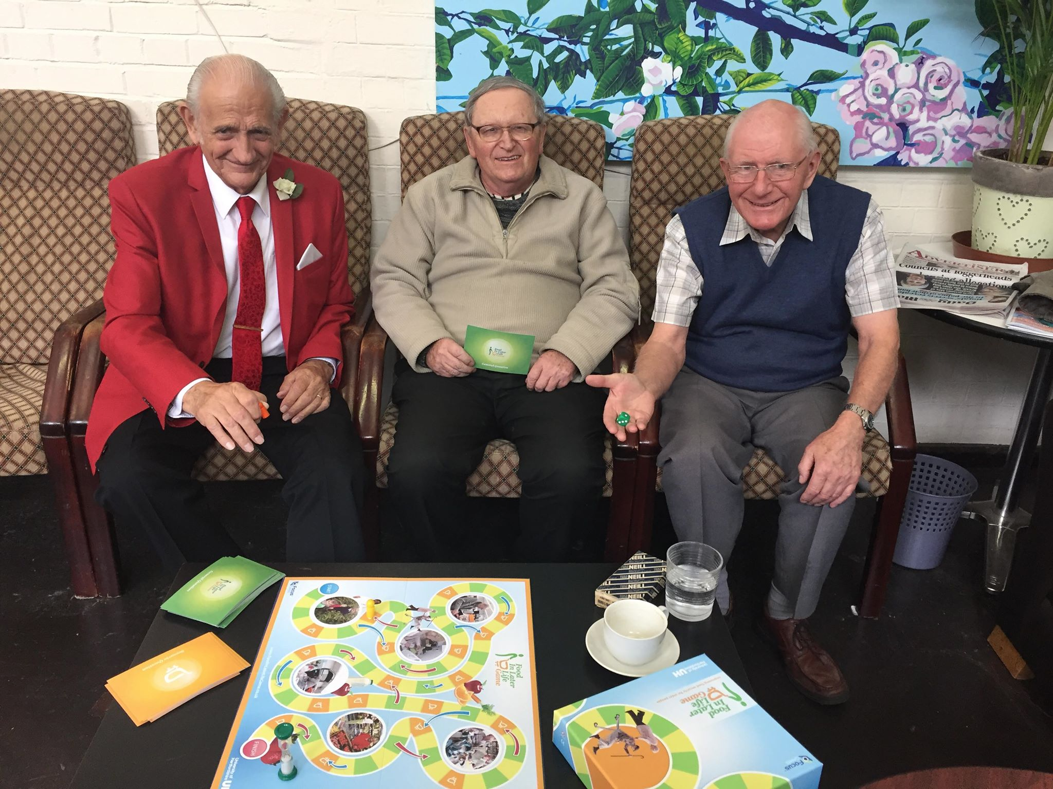

Thank you for listening.
Continue the discussion - w.j.wills@herts.ac.uk
@Wendy_J_Wills
go.herts.ac.uk/wendywills

Slide 24

The lived experience of ‘place’: film made with young people about food in/around schools in scotland
https://www.youtube.com/watch?v=mHqYzixQZrA

Slide 25
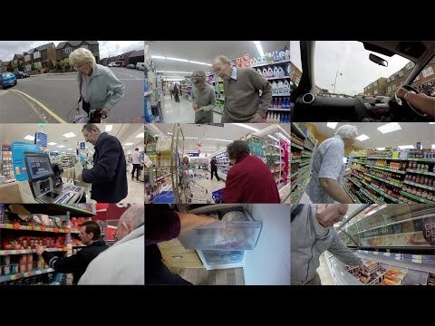
The lived experience of shopping in later life
https://www.youtube.com/watch?v=aCFN0xEMcjg&feature=youtu.be

