Slide 1
Families and Food in Hard Times
Outline:
Families and food
Conceptualising food poverty
Operationalising food poverty
Young people’s experiences
Implications
Dr Rebecca O’Connell, Senior Research Officer
Thomas Coram Research Unit, UCL Institute of Education
Household food insecurity measurement in Scotland:
Dec 2016 update and workshop
Serenity Café, Edinburgh 13th December, 2016

Slide 2
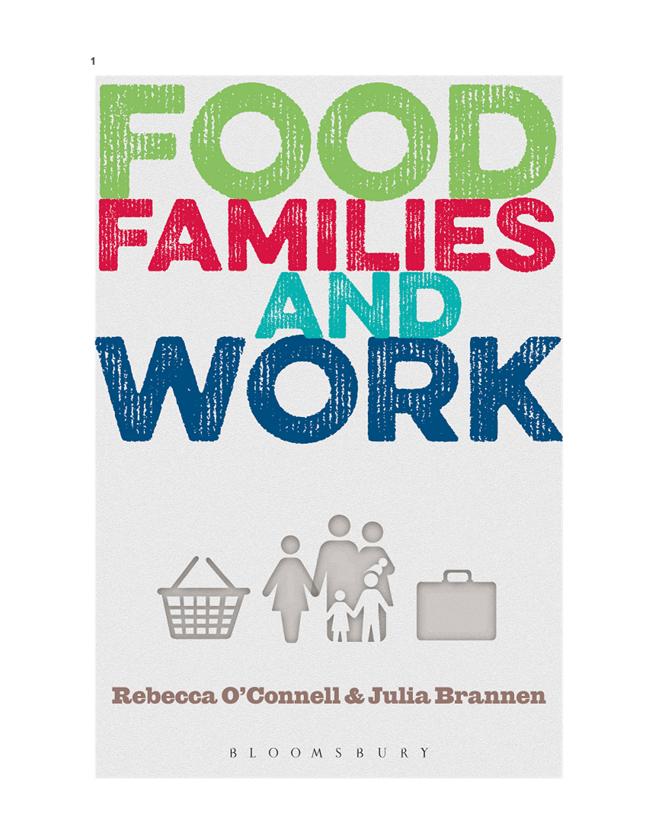
foodinhardtimes.org

Slide 3
Conceptualising food poverty
Poverty vs insecurity
(See Dowler et al., 2012; Lambie-Mumford 2014; Lambie-Mumford and O’Connell, 2015)
Food poverty
‘The inability to acquire or consume an adequate quality or sufficient quantity of food in socially acceptable ways, or the uncertainty that one will be able to do so’ (see Dowler et al 2001:2 and taken from Radimer et al 1992 cited in Riches 1997)
Expanded definitions include social participation (e.g. Friel and Conlon, 2004)

Slide 4
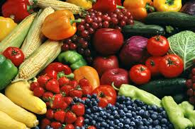
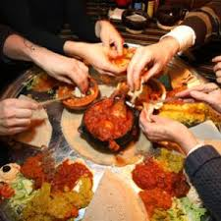
Food: the ‘intimate commodity’ (Winson, 1993)

Slide 5
Food, poverty and inequality
‘Individuals, families and groups in the population can be said to be in poverty when they lack the resources to obtain the types of diet, participate in the activities and have the living conditions and amenities which are customary, or at least widely encouraged or approved, in the societies to which they belong. Their resources are so seriously below those commanded by the average individual or family that they are, in effect, excluded from ordinary living patterns, customs and activities’ (Townsend, 1979: 31).

Slide 6
Operationalisation: secondary analyses e.g. LCFS and MIS
“Which types of families appear not to be meeting the lower spending threshold for a socially acceptable healthy diet that allows for social participation and how does this change over time?”

Slide 7
MIS
How much money do families need for a socially acceptable minimum standard of living?
The MIS ‘includes, but is more than just, food, clothes and shelter. It is about having what you need in order to have the opportunities and choices necessary to participate in society'.
Food Budget standard (FBS):
Consensual/expert
Includes social participation
Costed at Tesco

Slide 8
Operationalisation: qualitative research
135 families with an 11-15 year old in deprived urban and non-urban areas (45 families in each country)
Purposive sample: experiencing an aspect of food poverty; low income; employed & non-employed, lone & couple
Self completion screening questionnaire:
Subjective income adequacy; quantity; quality; worry; social participation
Q’s adapted from: USDA; PSE-UK; EU-SILC; LIDNS; FTT
Semi structured interviews with young people aged 11-15 yrs and parent/carer plus additional visual methods with subsample (45 in total)

Slide 9
Young people’s experiences
Food quantity and hunger
I was so hungry and that, so … all of a sudden yeah it was like … it was like … it was like I got hit on my belly…. like I got stabbed with a knife
I skip meals to share with my mum […] I personally skip a meal … for example […] I skip my meal to wait for her to come back and at least we can have the same amount of food […] starve together through the whole day, so at least we will have had something to eat
When I’m hungry I just can’t concentrate, it’s really, really hard for me to do that.
Food quality
We keep repeating the same food like over and over and over, just gets boring. Like just keep eating … but we can’t do anything about it, we have to just keep eating the same food.

Slide 10
Young people’s experiences
Stigma and shame
So when she was like ‘You can’t get that, you’re free school meals’ like I was really embarrassed cos people were waiting behind me, I was kind of like ‘Oh my God’.
Isolation/exclusion
‘I just watch them eating and I don’t eat, I just watch them eat’
Feels like I’m left out of the fun that happens and stuff. Like it just makes me feel empty
M: I’ve told my kids straight ‘You invite your friends round, tell them to bring their pocket money, I [can] barely feeds yous lot’
Notes:
PSE UK found that the proportion who could not afford to have a friend’s child round for tea or a snack once a fortnight had doubled between 1999 and 2012, from 4% to 8%, representing 1,000,000 children

Slide 11
Some reflections on definitions and measurement
Concepts, definitions, measures = highly political (Lister, 2004, Saunders 2013)
Importance of food for social participation = reflected in consensual definitions of living standards e.g. PSE UK and MIS
Also important in YP’s accounts of stigma and social exclusion
Narrow definition that reduces food to ‘nutrients’ = consistent with ‘food’ ‘solutions’ (charity; vouchers)
Alternative/additional qs that frame the ‘problem’ more broadly = consistent with multidimensional definition of (food) poverty, ‘right to food’ and minimum income approach
How to addresss intra-household variation including children’s experiences
Notes:
(but adapted preferences in austerity)

Slide 12
Selected references and further reading
Dowler, E., Turner, S. and Dobson, B. (2001) Poverty Bites: food, health and poor families. CPAG: London
Dower et al. (2011). Thinking about “food security”: engaging with UK Consumers. Critical Public Health 21,403-416.
Friel, S. and Conlon, C. (2004), Food Poverty and Policy. Dublin: Combat Poverty Agency, available at http://www.combatpoverty.ie/publications/FoodPovertyAndPolicy_2004.pdf
Lambie-Mumford, H. (2014). The Right to Food and the Rise of Charitable Emergency Food Provision in the United Kingdom. PhD Thesis, Department of Geography University of Sheffield, September 2014.
Lambie Mumford, H. and Green, M. (2015). Austerity, welfare reform and the rising use of food banks by children in England and Wales. Area.
Lambie-Mumford, H. and O’Connell, R. (2015). Food, poverty and policy: evidence base and knowledge gaps. Report. Available: http://speri.dept.shef.ac.uk/wp-content/uploads/2015/09/Food-poverty-policy-event-report.pdf
Lister, R. (2004). Poverty: Key Concepts. Cambridge: Polity Press.
Radimer, K., Olson, C., Greene, J., Campbell, C. & Habicht, J-P. (1992). Understanding hunger and developing indicators to assess it in women and children. J Nutr Educ 24(1):36S-45S.
Riches, G. (1997) ‘Hunger, food security and welfare policies: issues and debates in First World societies’, Proceedings of the Nutrition Society, 56, 63-74
Saunders, P.(2013) Down and Out: poverty and social exclusion in Australia. Bristol: Policy Press.

Slide 13
Thank you
rebecca.oconnell@ucl.ac.uk

