Slide 1




Right to Food Workshop
Community Food and Health Scotland Annual Networking Event
Perth
Wednesday 28th October 2015
Flora Douglas

Slide 2
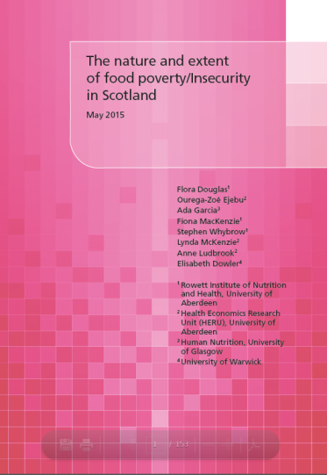
Scottish Food Poverty Study: Commissioned Aims
Consider broader questions of food poverty/insecurity in Scotland - beyond food banks.
Develop an understanding of the current level and nature of food poverty/insecurity with a view to informing policy makers and practice.
Examine food poverty/insecurity in relation to particular vulnerable groups and consider the implication of findings for the future work of community food initiatives.
NHS Health Scotland commissioned Oct 2014.
Published July 2015.
http://www.healthscotland.com/documents/25717.aspx
Notes:
Yet we know from the Canadian experience that food bank statistics are only providing a partial picture of the extent and nature of food poverty. For example
12-13% of the population are affected by food poverty at any one time - to a great or lesser extent.

Slide 3
Co-researchers
Ourega-Zoé Ejebu Health Economics Research Unit University of Aberdeen
Ada Garcia University of Glasgow
Fiona MacKenzie Formerly University of Aberdeen
Stephen Whybrow Rowett Institute of Nutrition and Health University of Aberdeen
Lynda McKenzie Health Economics Research Unit University of Aberdeen
Anne Ludbrook Health Economics Research Unit University of Aberdeen
Elizabeth Dowler University of Warwick

Slide 4
Methods
The research was designed as a linked series of studies.
Rapid review of the food poverty / insecurity literature pertaining to the Scottish context.
Interview study with 25 key informants concerned with the care and support of vulnerable groups or the operation or management of community food programmes throughout Scotland.
Secondary data analysis of relevant routinely collected food and fuel expenditure, food purchasing and self-reported consumption data using the Living Costs and Food Survey (LCFS), the Scottish Health Survey (SHeS), and the Kantar Worldpanel (KWP) datasets.

Slide 5
Terms of reference
This study was commissioned on the basis of the following definition of food poverty / household food insecurity:
‘The inability to acquire or consume an adequate quality or sufficient quantity of food in socially acceptable ways, or the uncertainty that one will be able to do so.’ Dowler (2003)
Notes:
Mention that as we know there is no agreed definition of food insecurity -
but that range that exist propose that the experience of household food insecurity is multidimensional and generally contain concerns for an individuals certainty (or uncertainty) and ability to obtain food of sufficient quality, quantity, that is safe, and that that they can so in social acceptable ways.
, Frequency of food consumption inherent on the FAO definition

Slide 6
Rapid review results
  Relative dearth of published food poverty research concerned with the Scottish context.
  Primary research has either focused on:
    dietary behaviour patterns - low income households consume a poorer quality diet compared to the wealthier counterparts.
    area-based research that has yielded mixed conclusions regarding the availability and accessibility of food quality food offerings and the relationship with dietary behaviours.
  No academic exploration of the economic ability to acquire food in the context of other necessary household expenditure in Scotland.
  Little exploration of the lived experience of household food insecurity.

Slide 7
Secondary Analysis (SA) Research Questions
Main goal was to determine the extent to which existing data could be exploited to investigate three key research questions:
  What is the current prevalence and nature of food poverty/insecurity in Scotland?
  What are the current trends in relation to food poverty/insecurity in Scotland?
  How are 1 and 2 above experienced by particular vulnerable groups – older people, those facing destitution, those living in rural and remote rural areas?
Notes:
The ‘at risk’ poverty threshold, was defined for this study as a household income below 60% of median equivalised household income – referred to as HBAI (Household Below Average Income).
The analysis also focused on
older individuals,
rural inhabitants,
those living in most deprived areas (1st SIMD).
LCFS (2007-2012), was used to investigate food and fuel income shares among HBAI and Non-HBAI, and older individuals - i.e. the proportion % of income devoted to those expenditures.
SHeS (2008-2012), was used to identify food consumption patterns. Where possible, food was selected to reflect the Scottish Dietary Goals, Eatwell Plate and 5-a-day intake of F&V.
KWP (2012), was used to assess dietary quality among those considered to be at risk of food poverty according to the purchased foods recorded in this dataset.

Slide 8
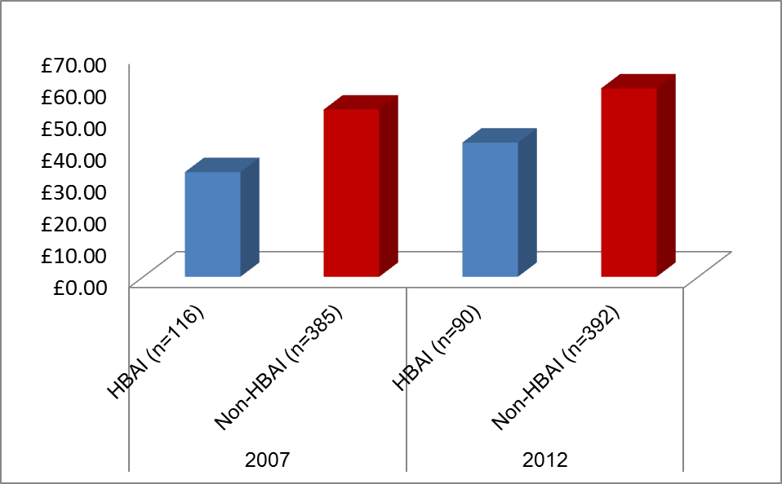
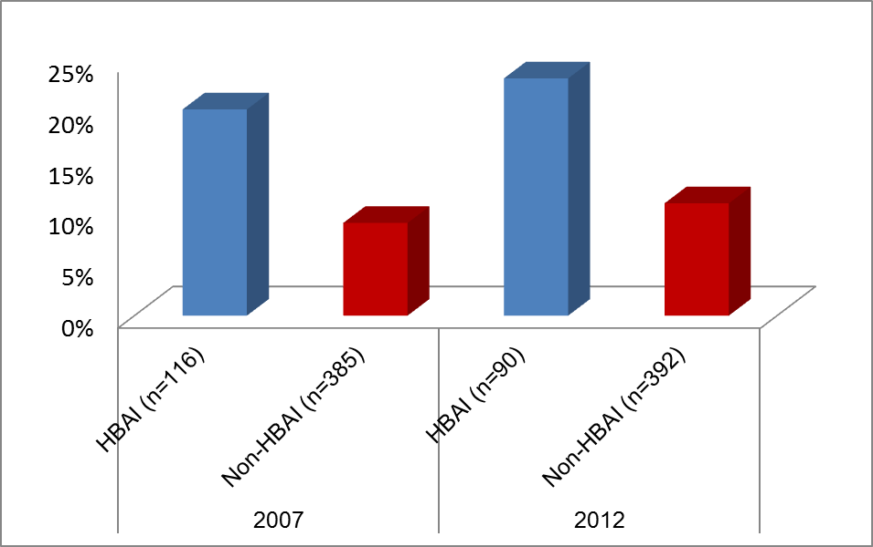
Food expenditure (LCFS)
(£s spent vs food income share)
Weekly food expenditure (absolute £) for HBAI and Non-HBAI
Proportion of equivalised income spend on food for HBAI and Non-HBAI
Notes:
These figures show the weekly food expenditure from the LCF survey in terms of pounds spent per week on food, and the proportion of equalised income spent on food in poorer (HBAI) and wealthier (Non-HBAI) households.
Poorer households in Scotland are spending less money in absolute terms on food, but are consistently spending twice as much of their income than wealthier households and this has been the case for some years.

Slide 9
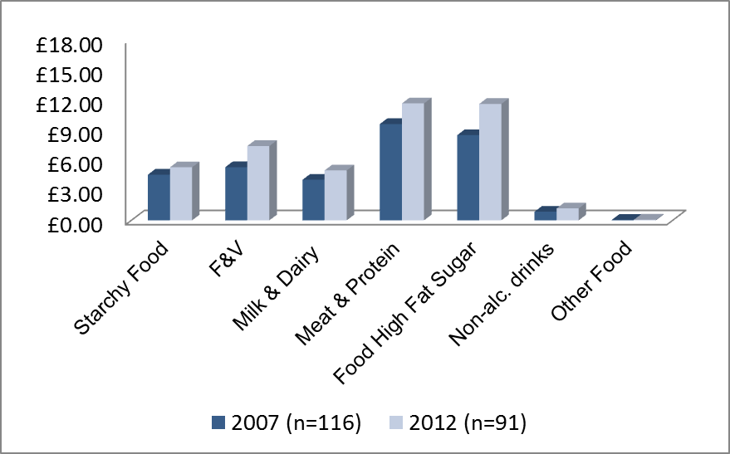
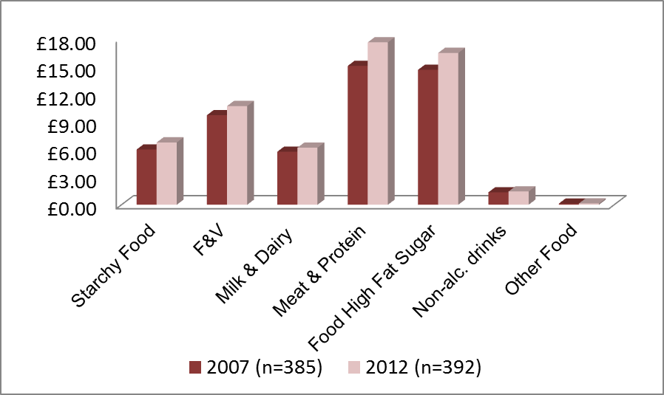
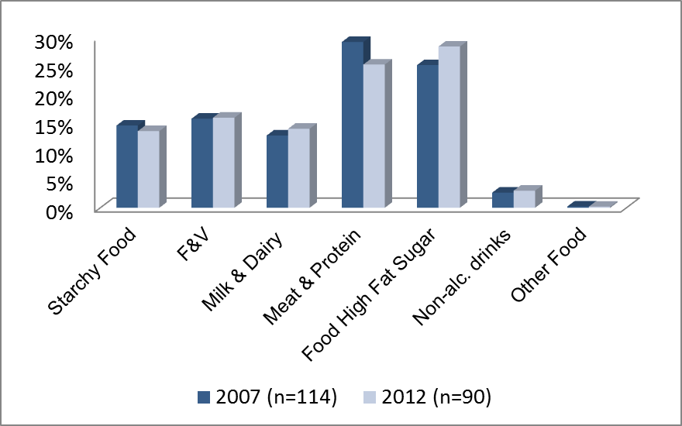
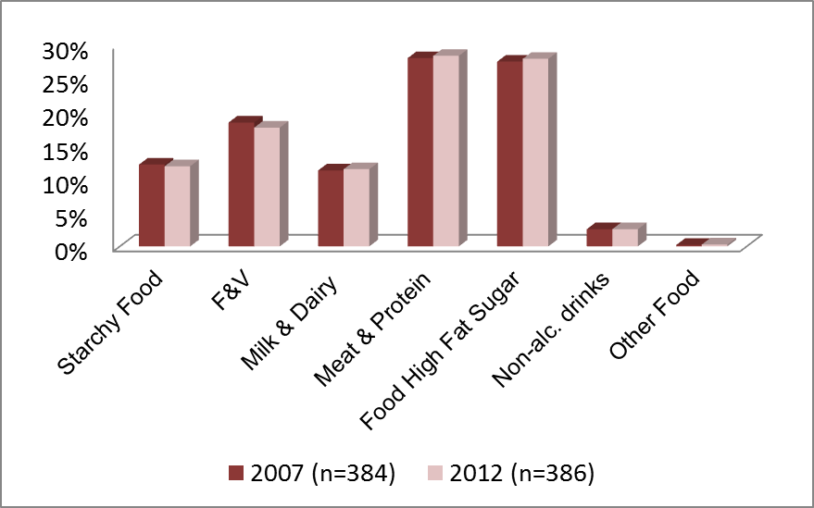
Food Group Expenditure (LCFS), 2007 & 2012
Weekly food expenditure by food group (£ per week) for HBAI and Non-HBAI
HBAI
Non-HBAI
Expenditure on food groups as % of equivalised household income for HBAI and Non-HBAI
HBAI
Non-HBAI
Notes:
These figures show the weekly spend on the Eatwell Plate food groups derived from the LCF survey.
It shows that both poorer households are allocating roughly the same food income share from their food budgets foods as wealthier households are, but poorer households are spending less money each week doing so, compared to wealthier households.

Slide 10
Other notable findings
Same spending patterns noted re expenditure on gas and electricity between HBAI and Non-HBAI.
HBAI spent less per household, but proportionally (%) more than Non-HBAI.
Fuel income share (%) are also larger for HBAI irrespective of the type of payment
No obvious differences in the frequency in the types of foods purchased or reportedly consumed between:
  Older individuals in HBAI households and Non-HBAI households.
  HBAI and Non-HBAI individuals living in urban or rural locations.
Area deprivation status appeared to make little difference to the types and frequencies of foods consumed by poorer households compared to wealthier households.

Slide 11
What the existing routinely collected data could not/cannot not tell us
The duration and frequency of constrained food intake (including hunger) at the household level
The degree of certainty or uncertainty associated with being able to put food on the table, and degree of anxiety associated with meeting this most fundamental of human needs.
The extent to which the manner in which food was procured for consumption, was done so in a socially acceptable way.
Notes:
Psycho-social stress and ill health theories
Changing social and scientific discourses on type 2 diabetes between 1800 and 1950: a socio-historical analysis
Since the emergence of type 2 diabetes as a public health threat around the middle of the 20 th century, accounts of disease causation have focused predominately on lifestyle or genetics, or both, while the role of broader structural issues such as psychosocial distress has been downplayed. Yet in the years prior to this emergence, when diabetes remained the preserve of the upper classes, medical experts drew upon multiple narratives when considering the condition, the most popular of which being the role of social organisation and the interplay between mind, body and environment. This article is based on a discourse analysis of the writings of the most prominent diabetes experts between 1800 and 1950 about both the causes and management of the illness. It highlights how, although the connection between lifestyle and diabetes was well established among physicians, individual-level explanations only fully supplanted the emphasis on social organisation as diabetes began to make the transition from being a disease of the rich to one of the poor. It argues that this discursive shift was shaped by the dynamics of class relations rather than any new forms of scientific evidence developed at the time.

Slide 12


Key Qualitative findings

Slide 13
Perceptions and views about what it means to be food insecure in the Scottish context
Being unable to behave like a normal consumer due to being on very low income or facing destitution.
Lacking choice and experiencing uncertainty about
  what an individual can buy to eat,
  when or where they are able to shop and eat.
Prevalent view that HFI in Scotland was synonymous with people being compelled to seek out nutrient poor, cheap food in order to balance the household budget and pay for other essential household costs, such as housing and energy/fuel.

Slide 14
Perceptions of groups most affected
More people from groups and sections of society never previously affected by severe food poverty found to be affected by it than recent years .
Groups considered most badly affected:
  young people on low, precarious incomes, as well as those at risk of destitution,
  households with young families,
  pregnant women,
  some groups of older people

Slide 15
Perceived causes of household food insecurity
Individual household financial shocks, i.e. sudden loss of income due to losing a job, benefit conditions/sanctions, falling ill.
Unpredictable incomes – variable income due to nature of work and so-called zero hours contracts
Low income/in work poverty
Lacking family and friends close by to call on for help with household food provisioning
Lacking skills to ‘cook from scratch’ - bottom of the list of causes
Notes:
The poverty threshold in this study did not necessary reflect the UK or Scottish median income since it was calculated according to the median income of each sample survey.
Small number of Scottish observations in UK surveys. Within country / regional analysis impossible.
Other associated costs required for the procurement and production of snacks and meals at home were unavailable.
Transport
Equipment

Slide 16
Food bank figures do not provide an accurate picture of the nature and extent of HFI in Scotland
More people were struggling with food poverty in Scotland than food bank figures.
There are an unknown number of people living in the community who have been referred to a food bank, but who have turned down such referrals.
Why this is the case is poorly understood – but shame and fear of stigma are thought to be among the main reasons.
NB. Trussell Trust food banks (the primary source of food bank statistics in the UK) are only one of many other providers of emergency food aid providers in Scotland – who may or may not be collecting use statistics.
  Aberdeen Food banks Partnership report 65 food banks are operating in Aberdeen City and Shire …..there are currently 400 Trussell Trust FBs in the UK as a whole.

Slide 17
Other Key Learnings
Only a partial picture of household food insecurity HFI was revealed by this analysis.
The extent to which subgroups are affected by HFI is not obvious from the secondary analysis of routinely collected food and fuel expenditure data, and self reported food consumption data.
Data currently available to monitor food poverty in the population does not collect data on other important domains of HFI, i.e. duration and frequency of constrained food access, uncertainty, anxiety, social acceptability.
Perceptions of pessimistic future re current trends.
Mixed views about the capability of emergency food aid providers being able to provide food in response to these predictions.
Notes:
Cite Radimer’s work in the 1990’s in the US, that informed the development the food insecurity measure now routinely used as the basis for food insecurity measurement both there and in Canada……..that the lived experience of food insecurity is characterised by a process of prolonged, health damaging descent towards hunger at the extreme end; i.e. an initial experience of anxiety, associated with worry about not being able to secure enough food for the family, followed by (if conditions continued to worsen) decreased amounts of food stored at home, followed by worsening quality and diversity of food eaten, then decreased quantity of food eaten through to skipping meals and going hungry.
Perceptions of those groups most badly affected by food poverty, maps onto Steve Fothergill’s analysis of the impact of recent Government reforms (including the previous Labour, Coalition and Conservative Governments) to social security reforms on areas, households and individuals in receipt of social security benefits, i.e. families with young children, lone parent families and young (employed and unemployed) people who have been most badly affected by the welfare changes, and had witnessed substantial reductions in their annual incomes as a consequence .

Slide 18
Rights-based approaches to food
The Right to Food (RtF) was first recognized in article 25 of the Universal Declaration of Human Rights in 1948.
Since then it has been recognized in a number of international instruments, with the International Covenant on Economic, Social and Cultural Rights ICESCR representing the most significant treaty on the right to food.
The Covenant (to date ratified by 162 States) shaped normative frameworks on the RtF.
The right to food as a distinct and fundamental right to be free from hunger and to have sustainable access to food (art. 11).
It outlines specific obligations for all States to take measures to progressively attain the full realization of the Right to Food.
  Hilal Elver (Special Rapporteur to the UN on the Right to Food - Access to justice and the right to food: the way forward 2015)

Slide 19
General Comment 12: ICESCR
The right to food is realised when every man, women and child, alone or in community with others, has physical and economic access at all time to adequate food or means for its procurement.

Slide 20
1st UN Special Rapporteur for Food Security defined RtF:
“the right to have regular, permanent and unrestricted access, either directly or by means of financial purchases, to quantitatively and qualitatively adequate and sufficient food corresponding to the cultural traditions of the people to which the consumer belongs, and which ensures a physical and mental, individual and collective, fulfilling and dignified life free of fear.” Zeigler, 2002

Slide 21
Three key dimensions of the RtF
Availability refers to enough food being produced for both the present and the future generations, therefore entailing the notions of sustainability, or long-term availability, and the protection of the environment.
Adequacy refers to the dietary needs of an individual which must be fulfilled not only in terms of quantity but also in terms of nutritious quality of the accessible food. It also includes the importance of taking into account non-nutrient-values attached to food, be they cultural ones or consumer concerns.
Accessibility (economic) implies that the financial costs incurred for the acquisition of food for an adequate diet does not threaten or endanger the realization of other basic needs (e.g housing, health, education). Physical accessibility implies that everyone, including physically vulnerable individuals, such as infants and young children, elderly people, the physically disabled, the terminally ill, and persons with persistent medical problems, including the mentally ill, should be ensured access to adequate food.

Slide 22
State obligations related to the RtF under the ICESCR
Respect
Prevents a state from placing barriers before those who want to feed themselves
Protect
Ensures no one interferes with another’s right to food
Fulfil
Facilitate by establishing an enabling environment and eliminate discrimination
Provide direct food aid when situations beyond a person’s control make them unable to provide for themselves

Slide 23
What the RtF is not
According to the FAO:
the right to food is not a minimum ration of calories, proteins and other specific nutrients, or the right to be fed. It is about being guaranteed the right to feed oneself, which means that food is not only available, .. but that it is also accessible – that households have the means to produce or buy it themselves. (Olivier de Schutter (2nd Special Rapporter on the RtF, 2012)

Slide 24
The Right to Adequate Food: What does this mean in Scotland?
The Right to Food is not incorporated in Scottish law, as yet, but is recognised under international law, and protects the rights of people to feed themselves in dignity, either by producing their own food or by purchasing it.
“Thinking about access to healthy food as a right, rather than as a privilege of those with sufficient purchasing power to buy food, fundamentally changes how we see the causes of and solutions to food insecurity. “
Anderson, M. (2013) Beyond food security to realizing food rights in the US Journal of Rural Studies 29 (113-122).

Slide 25
The Right to Adequate Food: What does this mean in Scotland?
If we believe that access to sufficient, nutritious food is a human right as specified above - what does this partial picture of HFI in Scotland presented today tell us about our current position in relation to enabling everyone in Scotland realise their Right to Food?

Slide 26
Acknowledgements
The research was funded by NHS Health Scotland, with support funding from the Scottish Government’s Rural and Environment Science and Analytical Services (RESAS), and the Health Economics Research Unit which is supported with core funding from the University of Aberdeen and the Chief Scientists Office
NHS Health Scotland: Bill Gray, Michael Craig, Dionne Mackison, Sue Rawcliffe, Graeme Scobbie, Lynda Brown & Rebecca Sludden
Poverty Alliance: Peter Kelly

Slide 27
Contact Details
Flora Douglas f.douglas@abdn.ac.uk

